Slide 1
VET student employment outcomes during COVID-19
Peter Fieger,
Federation University
p.fieger@federation.edu.au
The COVID-19 pandemic is exerting ongoing effects on societies globally, with ramifications felt across social and economic spheres worldwide. While the Australian labour market has so far escaped major upheaval, the VET sector has seen some significant changes with respect to employment outcomes for its graduates and short course completers. This study uses data from the 2019 and 2020 Student Outcome Survey to assess the impact of COVID-19 on employment outcomes of VET students in the early stage of the pandemic.

Slide 2
Student Outcome Survey
The National Student Outcomes Survey is an annual survey that collects information on vocational education and training (VET)
students’ reasons for training,
their employment outcomes,
satisfaction with training,
and further study outcomes.
The survey covers students who completed nationally recognised VET delivered by registered training organisations (RTOs) in the previous calendar year.
Qualification completers
Short course completers
Qualification part completers
Short course part completers
Subject only completers
NCVER selects the sample of students. (ca. 825,000, online)
Response rate boosters (email, SMS, phone)
Stratification, weighting to reflect population (incl. non response)
The 2020 SOS included a number of Covid related questions

Slide 3
Student Outcome Survey 2020
 | Unweighted |  |  | Weighted
Group | Frequency | Percent | Cumulative | Frequency | Percent | Cumulative
Qualification completer | 165,761 | 67.71 | 67.71 | 572,220 | 17.56 | 17.56
Short course completer | 17,048 | 6.96 | 74.67 | 78,041 | 2.4 | 19.96
Qualification part completer | 16,056 | 6.56 | 81.23 | 328,987 | 10.1 | 30.05
Short course part completer | 5,407 | 2.21 | 83.44 | 29,186 | 0.9 | 30.95
Subject only completer | 40,541 | 16.56 | 100 | 2,249,877 | 69.05 | 100
Total | 244,813 | 100 |  | 3,258,311 | 100

Slide 4
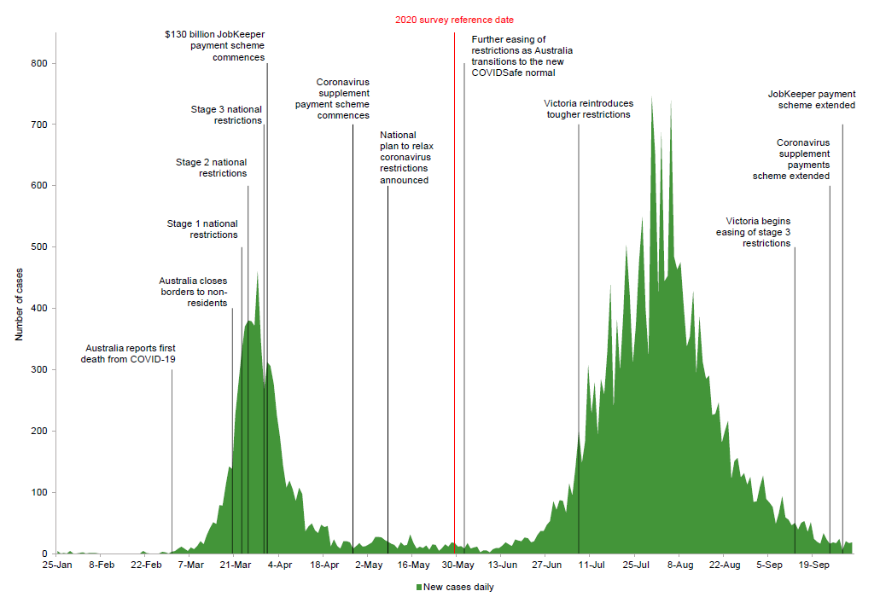
SOS 2020 in context

Slide 5
Methods used for this analysis; SOS 2020 only
2020 Questions (outright analysis of Covid impact as per 2020 SOS questionnaire)
Multinomial logit
Dependent variable(s)
Change of hours, job after training
Independent variables
Age groups, field of education, student group
Estimate of margins

Slide 6
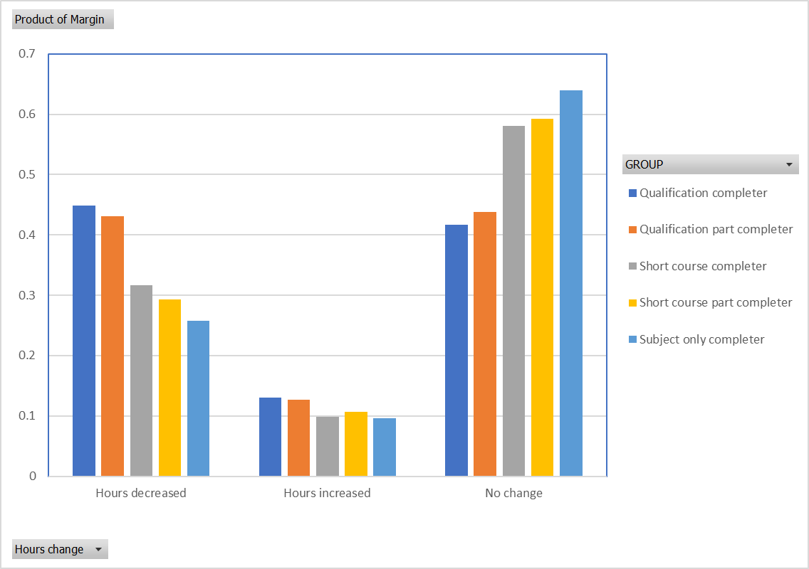
COVID related change in work hours

Slide 7
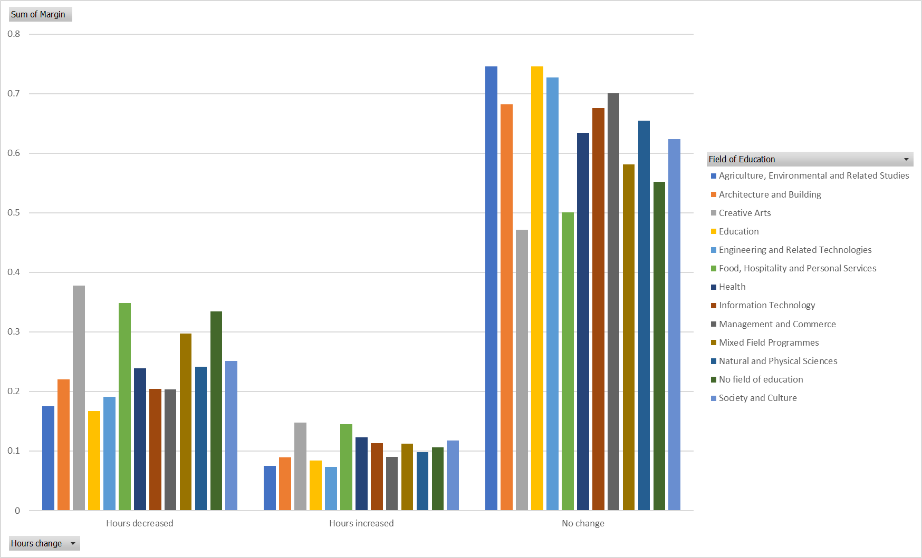
COVID related change in work hours

Slide 8
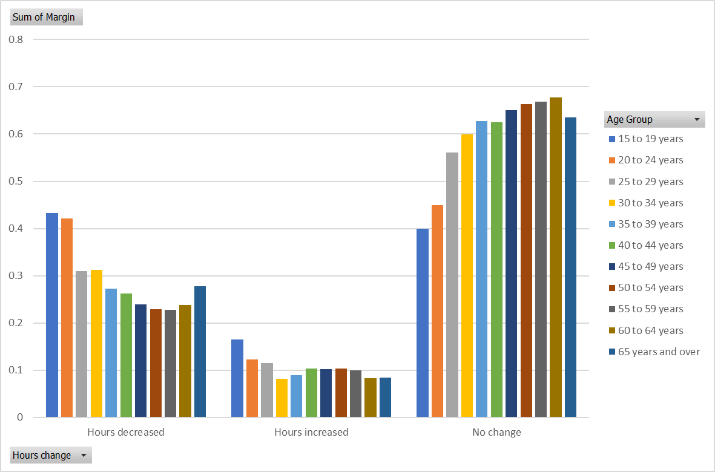
COVID related change in work hours

Slide 9
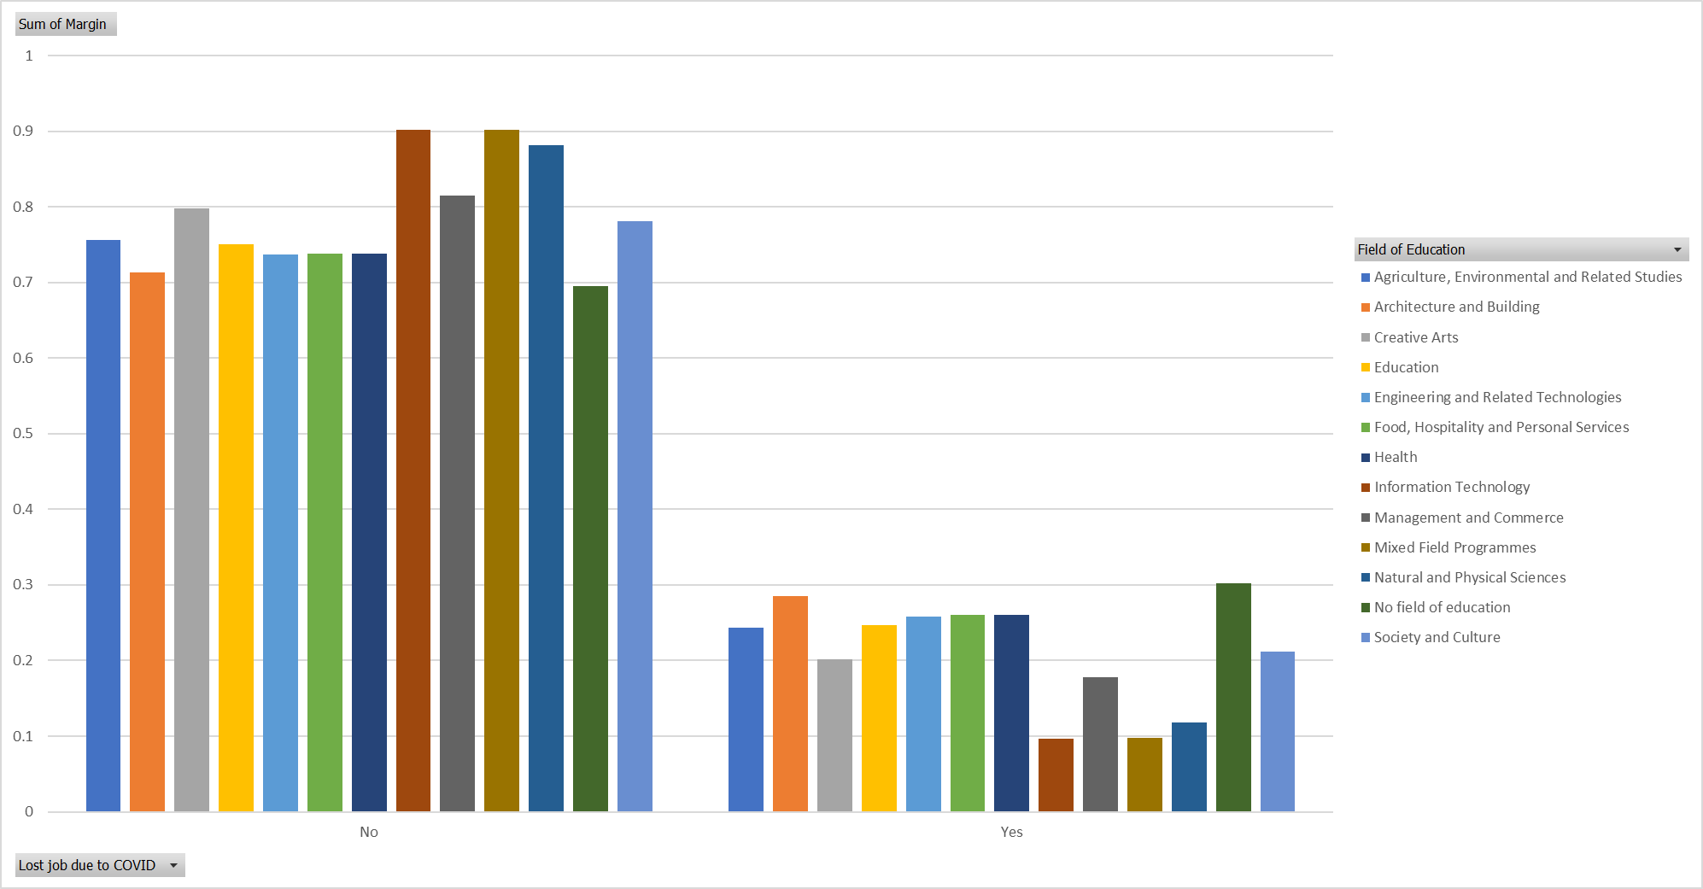
COVID related loss of job (if job was lost)

Slide 10
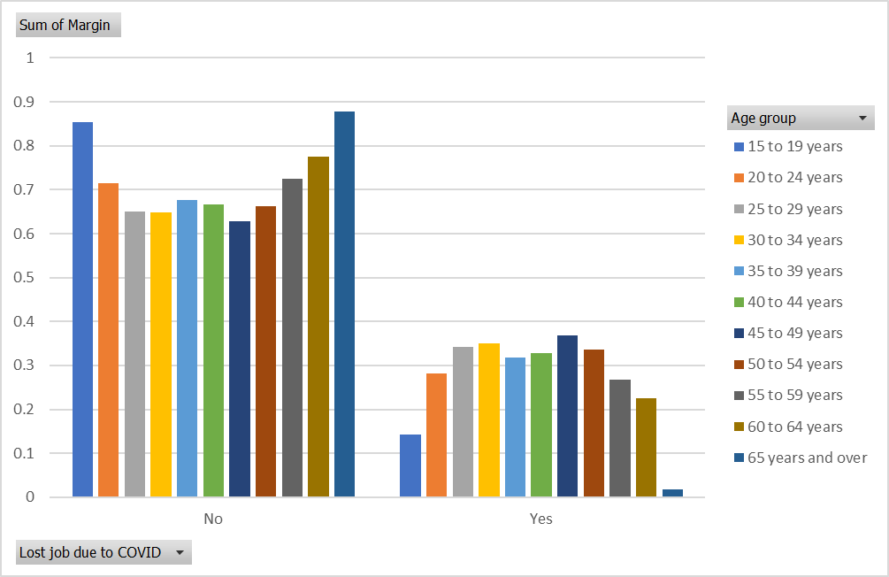
COVID related loss of job (if job was lost)

Slide 11
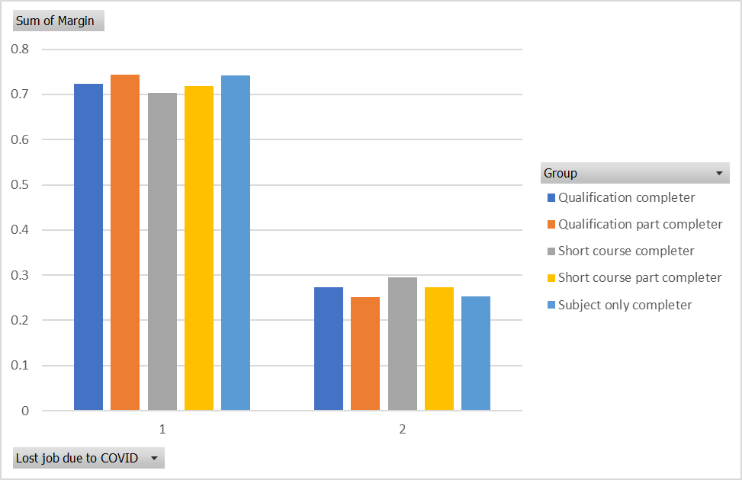
COVID related loss of job (if job was lost)

Slide 12
Methods used for this analysis; SOS 2019/2020
2019/2020 Questions (comparison of adjusted student outcomes)
Stacking of 2019 and 2020 data sets; create categorical indicator for year
Multinomial logit
Dependent variables
Job after training
Independent variables
Training package; age group (plus confounders and interaction with year categories)
The confounders enable removal of effects like changing characteristics of student cohort
Should ideally also include things like unemployment rate to focus on effect Covid only
Estimate of margins

Slide 13
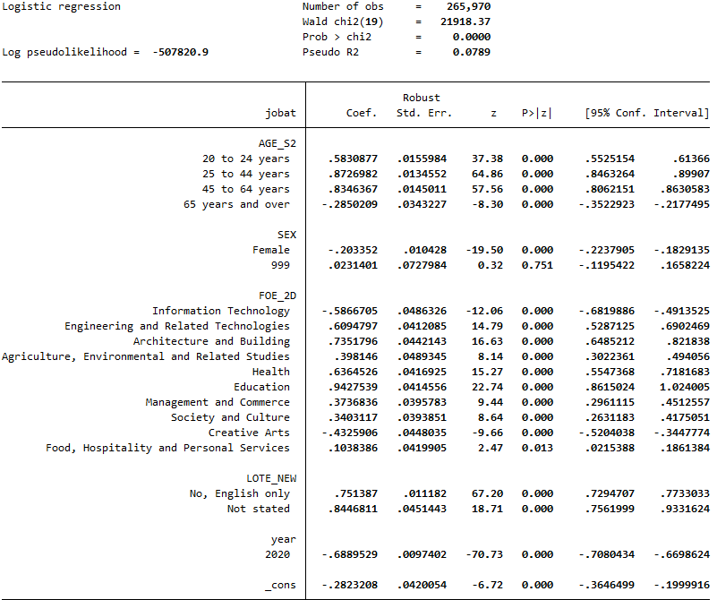
Statistical model used to determine VET labour market outcomes

Slide 14
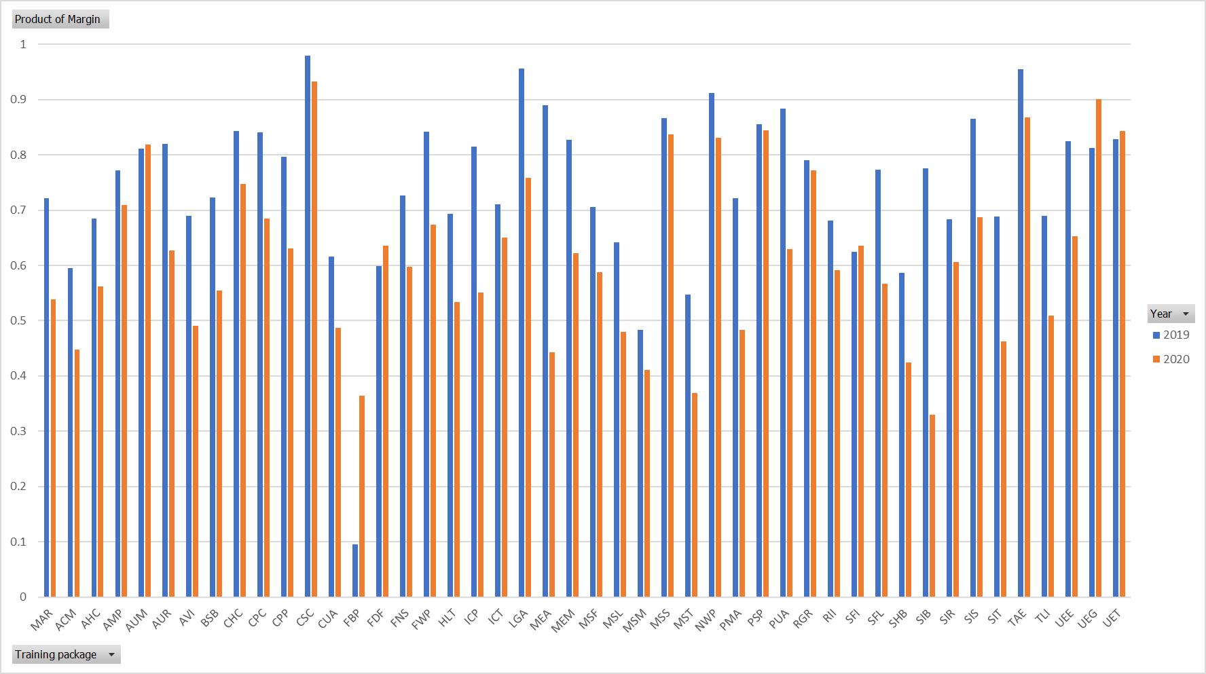
Adjusted Labour market outcomes by training package

Slide 15
Adjusted labour market outcomes for AQF graduates

Slide 16
Thank you.

