Slide 1
OctoberVET
25 November 2021
Gary Workman
Executive Director
www.aen.org.au www.gan-Australia.org

Slide 2
Agenda
Recent Apprenticeship Environment
Support Programs
“What will it take” report

Slide 3
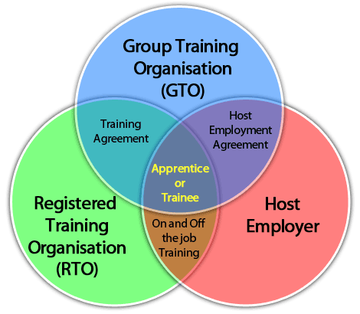
Group Training Organisations are an alternative way to start an apprenticeship
GTO benefits include;
Recruitment
Provides flexibility / rotations
Payroll and IR
Arrange the training
Apprentice mentoring
OH&S and PPE

Slide 4
Our members support a wide range of people across the State and employ over 6000 apprentices each year
www.aen.org.au

Slide 5
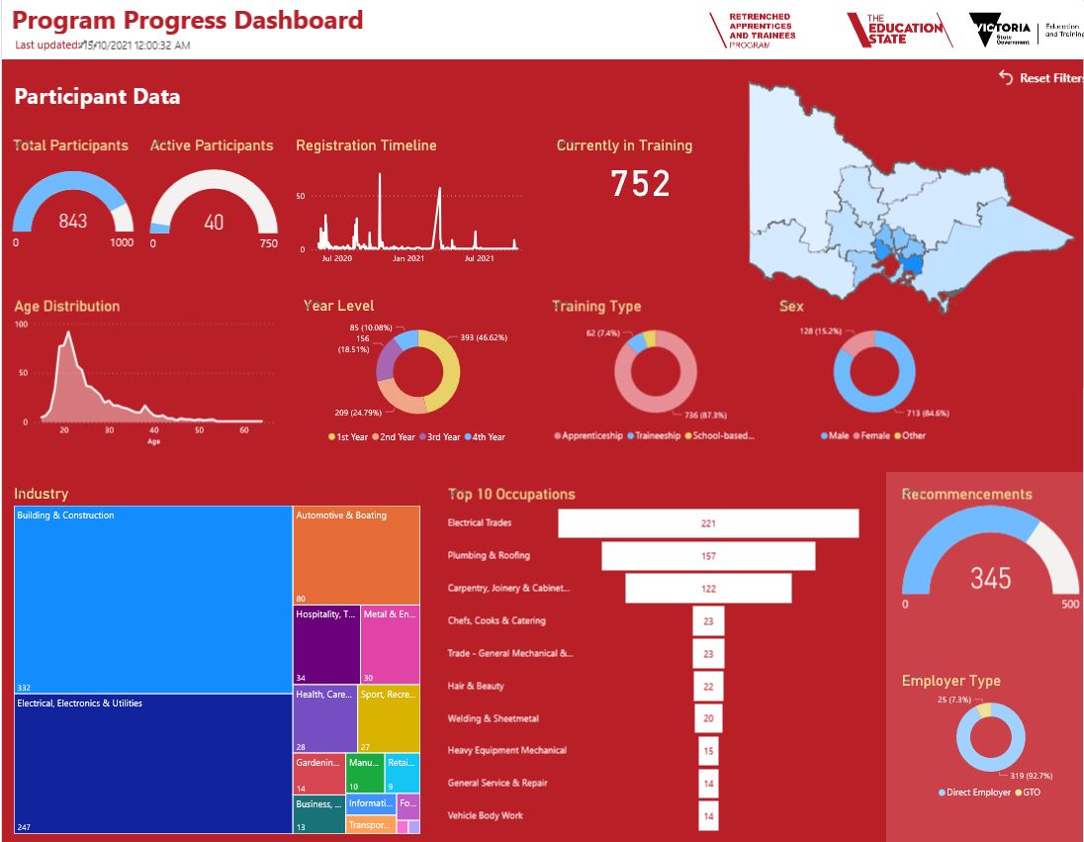
Current Apprenticeship environment
Recent challenges
Workplace / community lockdowns between April 2020 – October 2021
Apprenticeship suspensions / cancellations
Most effected include Hairdressing, Chefs, Automotive, Childcare,
Metropolitan Melbourne, Geelong, Gippsland, Shepperton
Mandatory workplace vaccinations
(reduced access to vaccinations for youth)
AEN providing a support service for retrenched apprentices and trainees
Hands-on training has been limited during COVID, creating delays in completing qualifications
Source: AEN Power BI report dashboard

Slide 6
Recent programs to support youth
Job seeker, Jobkeeper, Job Trainer programs
Boosting Apprenticeship Commencements 50% wage subsidy (Oct 2020 – March 2021)
Completing Apprenticeships 10% 2nd year, 5% third year wage subsidies (March 2022 – 30 June 2024)
Local Employment Facilitators (54 regions across Australia)
Victorian Government
Victorian Apprenticeship Recovery Program (local government agencies & bush fire effected regions).
Jobs Victoria – Employment Facilitators, specific Jobs Victoria programs
New Apprenticeships Victoria – Victorian Major Projects (over $20m) – 1500 apprentices, Social Procurement requirements, MPSG 10% of the workforce to be apprentices/ trainees/ cadets.
Local Jobs First - Major Projects Skills Guarantee

Slide 7
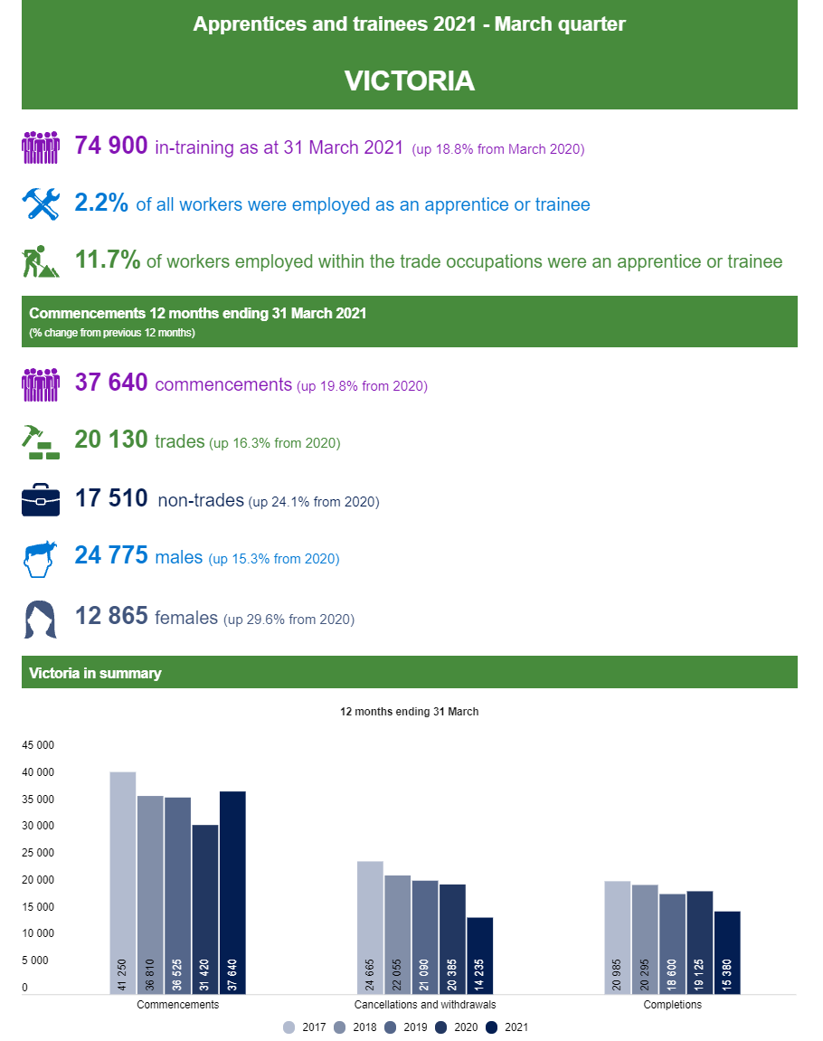
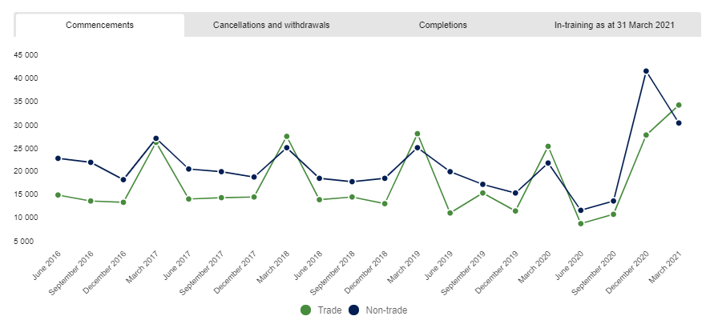
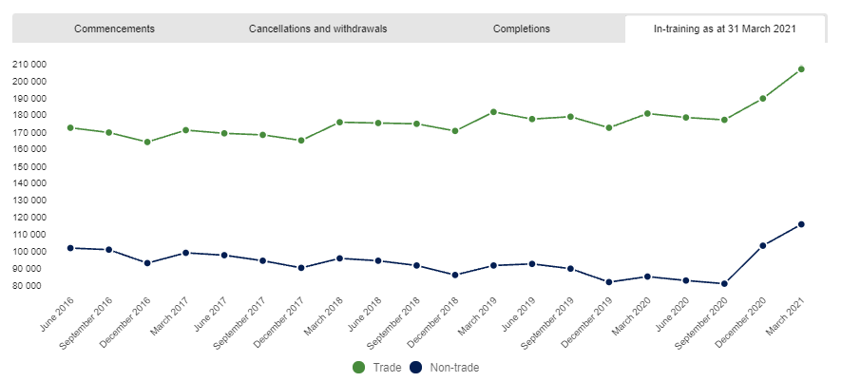
In-training as at 31 March 2021
There were 329 585 apprentices and trainees in-training as at 31 March 2021, an increase of 20.7% from 31 March 2020.
Quarterly training activity
In the March quarter 2021, compared with the March quarter 2020:
• commencements increased by 35.4%, to 66 635
• completions decreased by 9.4%, to 20 010
• cancellations and withdrawals increased by 5%, to 22 140
Source: NCVER March Quarter 2021 Apprenticeships

Slide 8
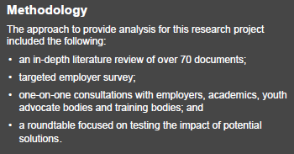

Slide 9
The challenge
Over the last decade quality job opportunities for young people in Australia have declined.
Underemployment has increased, average working hours reduced. Young peoples’ wages have gone backwards. In 2020 the Productivity Commission found that young people are starting further down the career ladder and climbing it more slowly.
It suggested that rather than focussing on unemployment, we need to start talking about the types of jobs young people are getting. Despite long term skills shortages across many parts of the labour market, there is a lack of employment pathways for young people that allow them to apply and develop their skills.
We should expect this to worsen in response to COVID-19, as it has in response to past economic shocks. Uncertain economic times make employers reluctant to make long term commitments to new recruits and reduce their inclination to hire inexperienced workers. Training budgets are often the first to be cut.
It is clear that Government action can make a difference. The Boosting Apprenticeship Commencements scheme (BAC) 217,000 (Nov 2021) has been effective in increasing the number of apprentices and trainees hired, including amongst employers new to the apprenticeship system. Governments have successfully used major infrastructure projects to drive investment in construction skills. Individual employers, too, have developed innovative new pathways for young people into and within their organisations, proactively engaging with low income and marginalised groups.

Slide 10
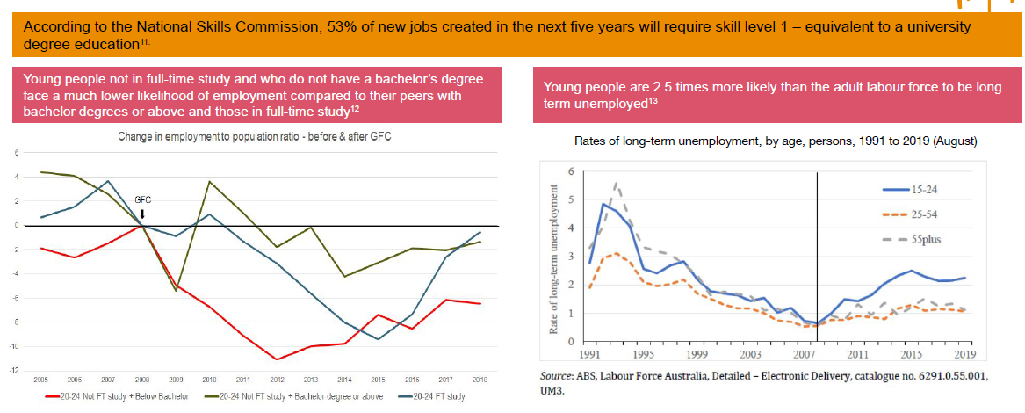

Slide 11
Themes from literature
Number of full time entry level positions has declined
Employer contribution to training has been falling
Employer perceptions of young people and lack of sense of responsibility to nurture new entrants, contributes
Reduction in recruitment pathways in larger public sector (privatisation, corporatisation) and private sector (increased use of contractors, labour hire) employers. More fragmented labour market.
Employer demand for experience/qualifications, even in ‘entry level’ roles.
Lack (loss?) of expertise & internal structure to bring in young people.
Challenges in employers engaging with employment programs (eg, jobactive) around career pathways – misalignment of objectives and expectations.
Initiatives to improve pathways are often ad hoc/short term, no reliable, consistent support.

Slide 12
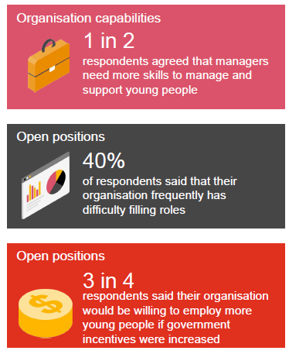
Key findings from employer research
There are some exceptional employer initiatives and examples of ‘what works’.
But not enough to address the problem.
Many employers are not set up to engage and support young workers:
Identify need for workers who are ‘productive from day 1’ (half say their staff don’t have time to supervise young workers)
Say that young workers need more mentoring/support than usual
60% say supervisors/TL lack skills to manage & support young workers
Cost is a significant factor
75% say they would take on more young people if incentives higher
61% say that cost is an important factor in limiting young peoples access to training
But current incentives often seen as ‘more trouble than they are worth’
Intermediary support is not hitting the mark
Skills shortages are self-perpetuating, as more experienced workers are kept ‘on the tools’ rather than deployed to skill up future workers.

Slide 13
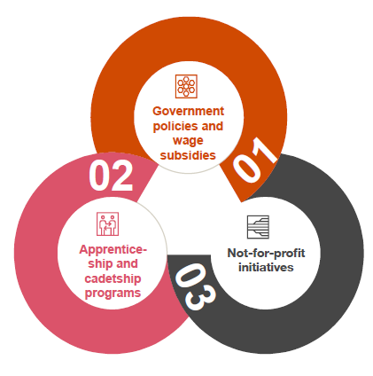
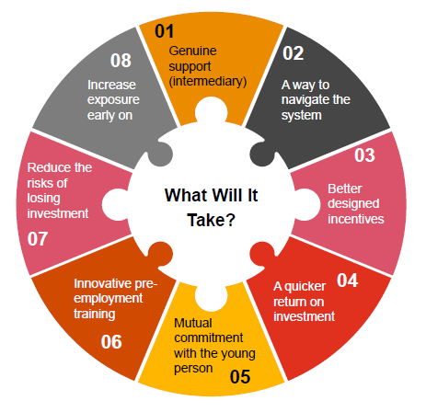
What has been tried
Strong focus by government on Wage subsidies and a wide range of local programs
What employers need!
Strong support to find and support youth
Support to navigate the VET system

Slide 14
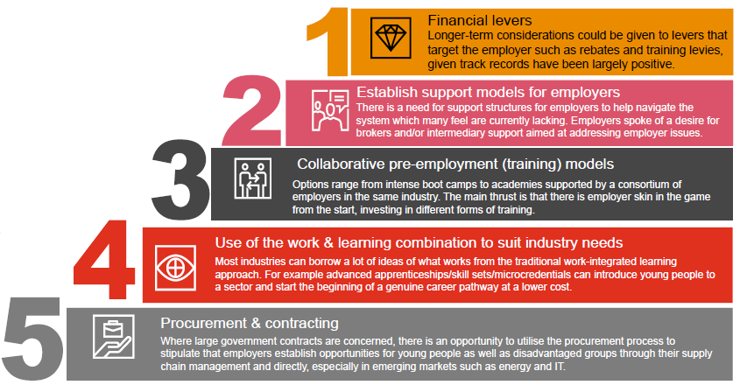
Key Findings
It is clear from this research that a combination of measures is needed to generate change. We identified five broad approaches, some combination of which should be considered:
We have identified a number of possible next steps to test and refine these ideas. Importantly, we need to recognise the urgency of the problem and to develop a more coherent response which recognises the need to address skills development and employment together, not in isolation.

Slide 15
Next Steps
What we could do next:
Using this paper as a starting point for co-design of a strategy to integrate current skill organisation pilots with support for employers who are willing to create additional entry points for young people, particularly those facing disadvantage.
Trialling a combination of procurement targets in large IT contracts, new training/work integrated learning models and enhanced intermediary support to accelerate creation of job pathways into the IT sector;
Piloting the use of an enhanced Group Training Model, with funds to deliver pre-employment and other support, to bring together employers and create better supported pathways for young people in SMEs;

Slide 16
Thank you for your time
Gary Workman
Executive Director
03 9639 3955 gary@aen.org.au
To access the full report please visit
www.aen.org.au www.gan-Australia.org

