Slide 1
Fed Uni’s international research on Apprenticeship
Research undertaken for the International Labour Organization
Professor Erica Smith
e.smith@federation.edu.au

Slide 2
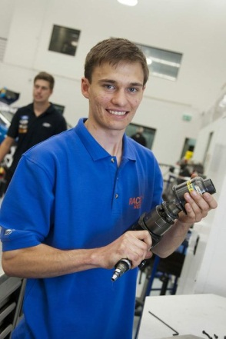
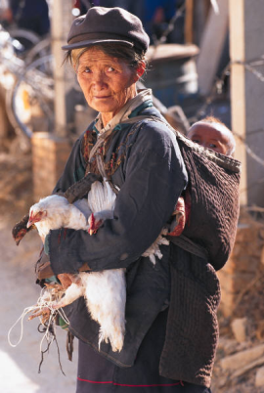
Societal expectations
Apprentices
Countries: Solve youth unemployment
Countries: Address youth disengagement
Help women; and workers in the informal economy
Trade unions: Improve working conditions through apprenticeships
Parents: Get children into a secure job.

Slide 3
Economic expectations
Apprentices
Companies: A well trained workforce
Companies: Develop future managers
Companies: Improve productivity and profits
Countries: International Competitiveness

Slide 4
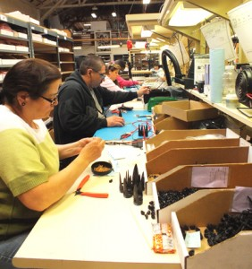
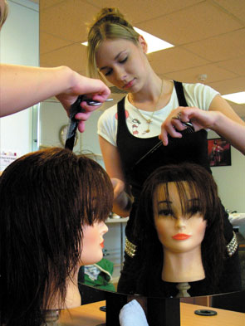
Possible futures for the Indian apprenticeship system 2012 with Ros Brennan Kemmis
Country case studies on 11 countries’ apprenticeship systems, written to a specified format by a team of country experts, validated by in-country academic and government experts;
Cross case analysis of the country case studies including a summary of the issues, strengths and weaknesses;
Development of a framework for a model apprenticeship system, including the identification of key features grouped under the headings engagement, quality, outcomes, and public policy implications.
Suggested application to India, presented in New Delhi to 80 stakeholders

Slide 5
Indian apprenticeship system update
For ILO Geneva office and the OECD 2016
‘India’ case study on employer engagement in apprenticeships, OECD’s ‘LEED’ project project on employer engagement in skills development. Recorded changes in the Indian system, some of which had been recommendations of our 2012 project.
Presented to Australian Government/OECD Workshop, Adelaide, June 2016.

Slide 6
A new model of apprenticeship for Indonesia 2017
For ILO’s Jakarta office
Research, Review and Development of a Revised Model of Quality Apprenticeship for Indonesia.
This project has involved Erica in interviews with stakeholders in and near Jakarta, and collaboration with ILO staff to produce a new model for apprenticeship in Indonesia, which we presented at a tripartite meeting in Jakarta in September 2017.
Pilot projects to trial our model are anticipated.

Slide 7
Apprenticeship’s role in addressing youth unemployment, 2017
For ILO’s Bangkok office
This project has involved research and analysis on the role of apprenticeships in addressing youth unemployment.
Erica presented the results at a forum in Bangkok in October 20017: The Regional Skills Meeting on Skills and the Future of Work: Strategies for an Inclusive Growth in Asia and the Pacific. The forum consisted of international experts and tripartite participants from six countries.
Feedback is being incorporated into a final version which will be disseminated through a book to be prepared by the ILO.

Slide 8
Progress of G20 countries in apprenticeship initiatives
For ILO’s Geneva office
Erica Smith with the assistance of RAVE member Jackie Tuck: Collaboration on ILO survey report of national initiatives to promote quality apprenticeships in G20 countries.
This project will involve the analysis of data from a survey sent by the ILO to three respondents in each country, representing government, labour unions and employer bodies. The context for the project can be seen in the G20 Hangzhou communique (item 40) at http://europa.eu/rapid/press-release_STATEMENT-16-2967_en.htm

