Slide 1
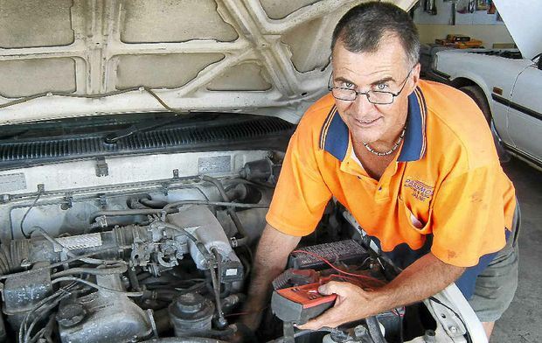
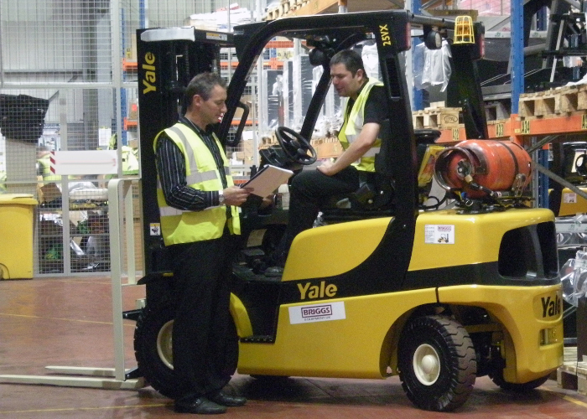
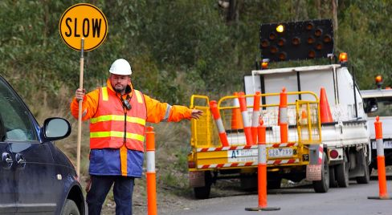
Supporting mature aged workers transition into a new field of work via an apprenticeship
Gary Workman – Executive Director
November 2018

Slide 2
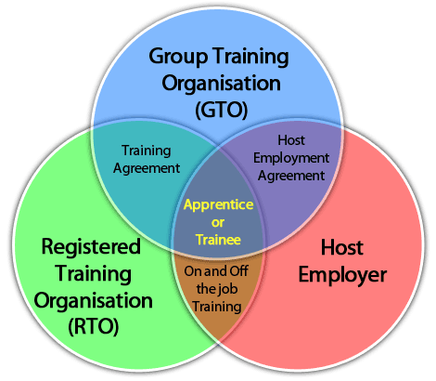
Group Training Model
GTO benefits to host employers include;
Recruitment
Provides flexibility / rotations
Payroll and IR
Arrange the training
Apprentice mentoring
OH&S and PPE
Over coming perceptions
Improving “self” worth/ confidence

Slide 3
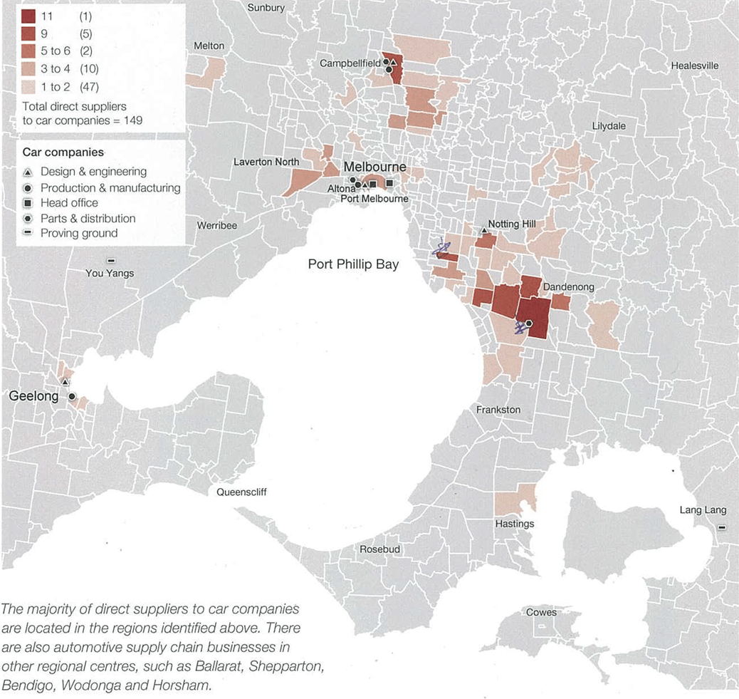
Current Environment in Victoria
Victorian Government assistance to support mature aged workers transition into a new apprenticeships and other forms of employment
Auto manufacturing industry and second tier manufacturing industry (12,000+) (150+ bus)
Coal fired power generation in the Latrobe valley
Employers encouraged to support mature aged workers

Slide 4
Current Environment in Victoria
Challenges
South East Auto Transition Project (SEAT)
Ave age 42, average time in industry 15+y
Many workers have gone into “semi retirement” – not looking for full-time work or have started their own small business
Many workers were in “well-paying” employment $60k+
(ave apprentice/ trainee wage $40k)
Workers “under valued” their skills and experience and ability to re-train.

Slide 5
Advantages of employing mature aged workers
Mature aged workers have often built up knowledge and skills during their time in the workforce, so they can help you to:
look at your business operations from a different perspective
improve your business processes
fill any skill or knowledge gaps in your workplace
provide mentoring to less experienced employees
train up your employees by sharing skills.
There is evidence that mature aged workers can:
save you money due to lower rates of absenteeism
make your business more productive
help you learn and adjust to new technologies in the workplace.

Slide 6
Advantages of employing mature aged workers
It makes good business sense to consider hiring more mature aged workers. Over the next 10 years, the Australian population will see:
a decreasing number of young people entering the workforce
an increasing number of older workers staying in the workforce.
If your business welcomes mature aged workers, you'll be seen as a more attractive employer to a growing proportion of the workforce.

Slide 7
Our experience & feedback from Employers
Employers value mature aged workers
Understanding of work requirements – systems & processes
Reliability, maturity, communication skills and experience
Mentors for younger apprentices/workers

Slide 8
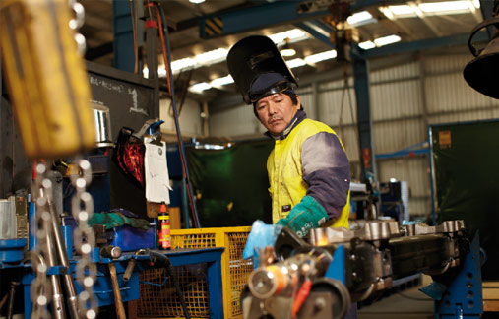
Interest from both employers and Mature aged workers
Potential Apprenticeships (2+ years)
Automotive mechanic
Automotive panelling
Civil Construction
Carpentry / construction trades
Potential Traineeships (12 months)
Civil Construction (traffic management)
Warehousing & Transport
Auto parts and servicing
OH&S and supervisory roles
Business Administration

Slide 9
Mature Aged Apprentices – Wage Expectations
Industrial Relations
Over 21yo. most awards 80%+ of min. adult wage
Wage support for employers to assist with closing the wage gap
State and Commonwealth funding for wage support
Depending on individual circumstances and background
Funding up to $20k spread over initial 1-2 years
Victorian AEN SEAT $6-10K
Commonwealth Apprenticeship $4k
Commonwealth Mature aged assistance (restart) $4-10k
Notes:
Vic B2W $4-10k
Vic AEN SEAT $6-10K
Comm $4k
Mature aged $$4-10k
Existing Salary $45k+ - expectations / needs to be close

Slide 10
Example GTO Delivery model
4-8 weeks up front full-time training at an RTO (paid salary)
Initial assessments of competency & RPL completed
Individual training plan completed with GTO / Host employer
Mature aged apprentice then integrated into “standard” RTO apprentice training
Early examples from SEAT indicate that mature aged workers are competent and have the ability to be “fast tracked” with entry level apprentice/trainee qualifications, leaving greater time to improve more complex skills required through combination of RTO and the employer/ workplace.

Slide 11
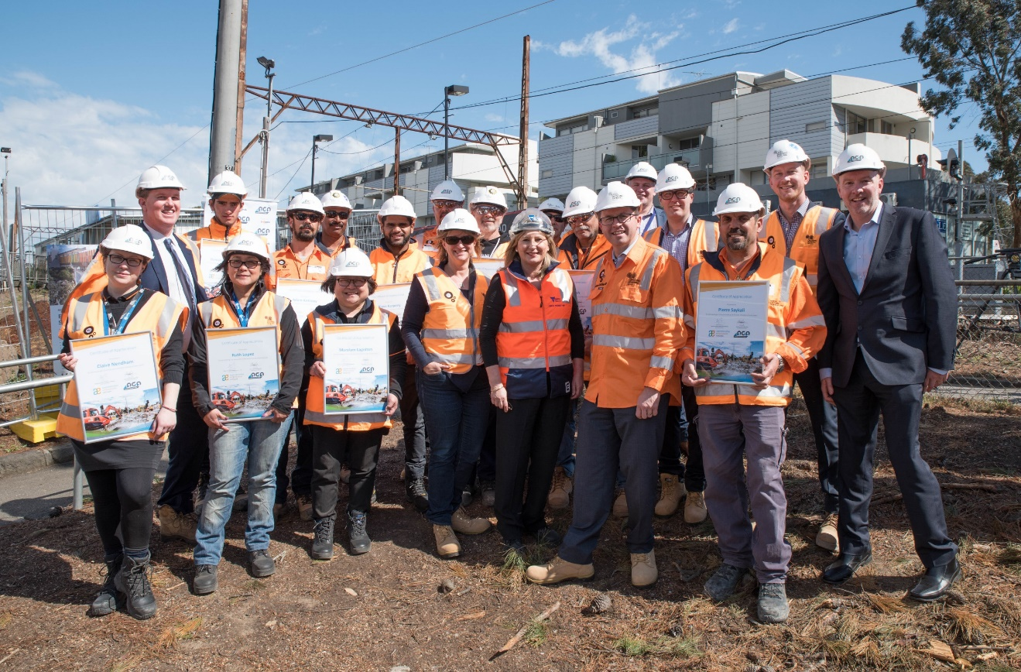
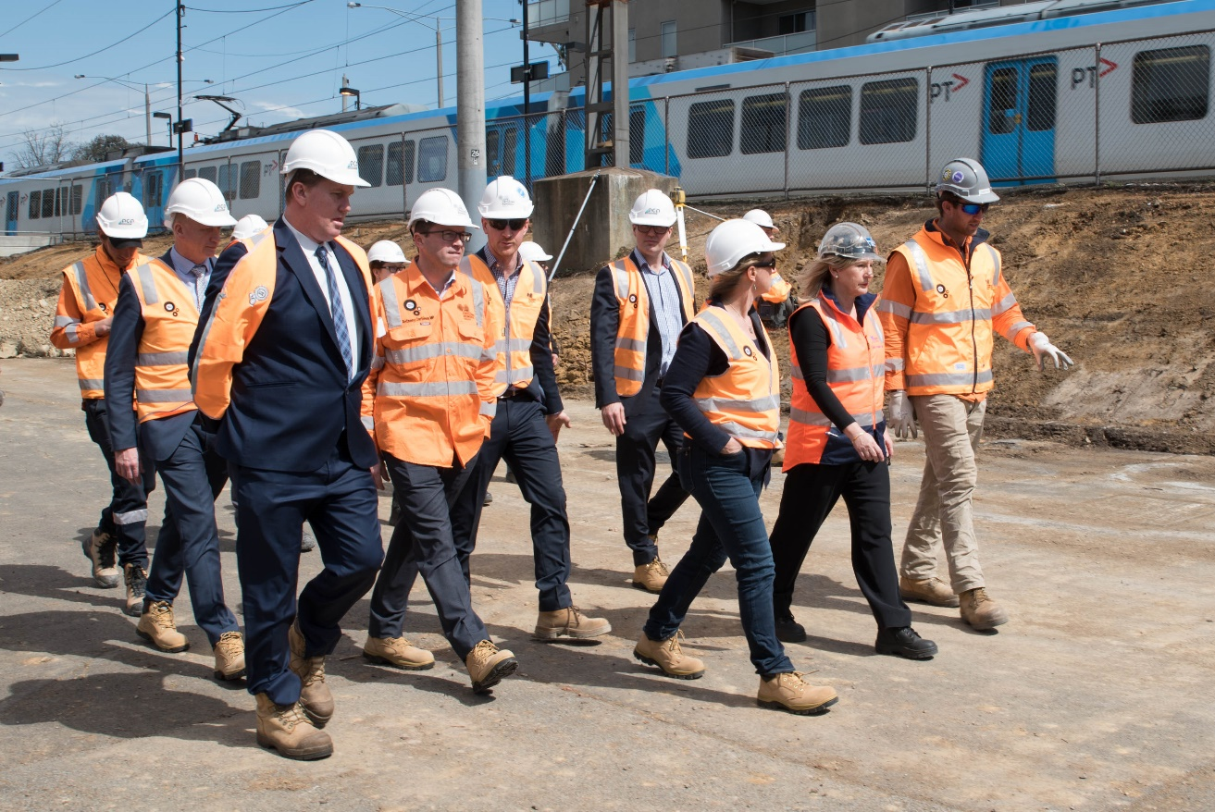
Civil Construction
Level crossing removal
NEPA & AGA
Full time civil construction & business administration traineeships
All training completed on the job – group training directly related to work tasks
12 months – complete certificate IV
Recognition of existing skills & experience

Slide 12
Areas where support is required
Fear of the unknown!
Understanding the education / training sector
Returning to training / education
IT support / online enrolments / information
Work based or school based training
Written reports / assessment tasks
Developing a “career plan” / training plan.
Commonwealth Government resources
https://www.business.gov.au/people/hiring/equal-opportunity-and-diversity/mature-aged-people
Employer toolkits & wage subsidies information

Slide 13
Thank you for your time – Questions?
Gary Workman
Executive Director
Level 3 478 Albert Street
East Melbourne 3002 VIC.
E: gary@aen.org.au
T: 03 9639 3955
www.safetyfirst.org.au
www.aen.org.au
www.needanapprentice.com.au

