Slide 1
Young people and the COVID-19 labour market:
Insights from ‘PISA 2018’
Dr Anthony Mann
Senior Policy Analyst (Education and Skills)
OctoberVET, November 2020
Twitter: @AnthonyMannOECD
Anthony.mann@oecd.org

Slide 2
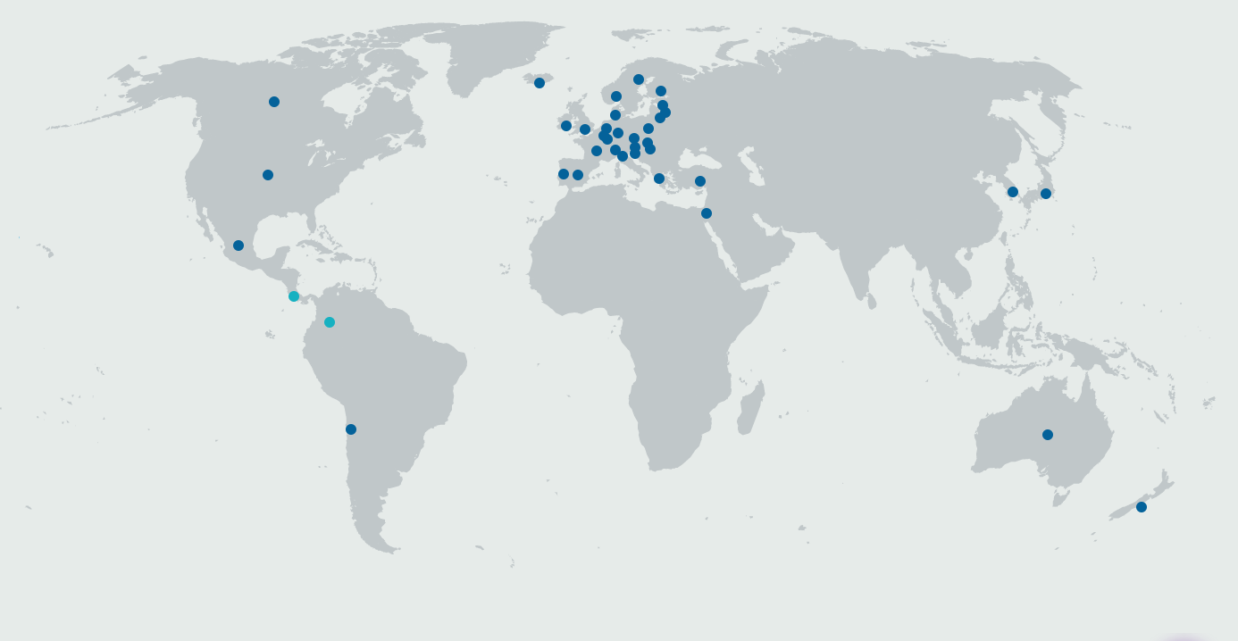
About the OECD
The Organisation for Economic Co-operation and Development (OECD) is an international organisation in which governments work together to come up with solutions to common problems, develop global standards, share experiences and identify best practices to promote better policies for better lives.
OECD 38 member countries and 5 key partners represent about 80% of world trade and investment
MEMBERS
Australia
Austria
Belgium
Canada
Chile
Colombia
Costa Rica*
Czech Republic
Denmark
Estonia
Finland
France
Germany
Greece
Hungary
Iceland
Ireland
Israel
Italy
Japan
South Korea
Latvia
Lithuania
Luxembourg
Mexico
Netherlands
New Zealand
Norway
Poland
Portugal
Slovak Republic
Slovenia
Spain
Sweden
Switzerland
Turkey
United Kingdom
United States
European Union
Brazil
China
India
Indonesia
South Africa
KEY PARTNERS
@AnthonyMannOECD

Slide 3

About the Programme for International Student Assessment (PISA)
@AnthonyMannOECD

Slide 4
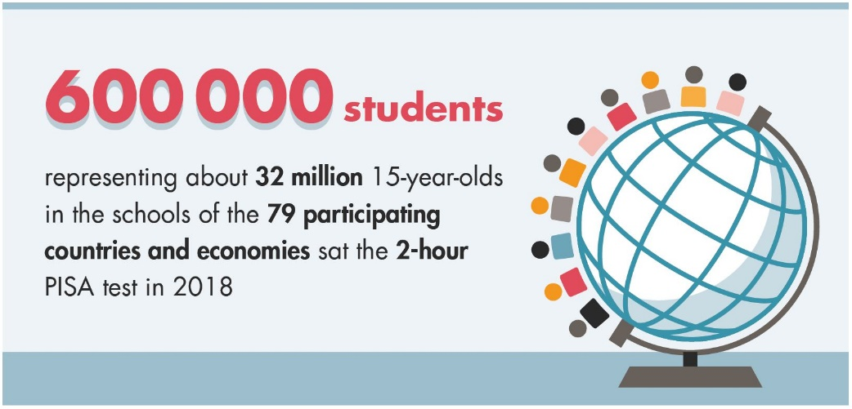
PISA 2018
In Australia, 14 273 students, in 779 schools, completed the assessment, representing 257 779 15-year-old students (89% of the total population of 15-year-olds).
Australia is one of 32 countries where students also completed the PISA Educational Career Questionnaire investigating young people’s career readiness.
Notes:
PISA asked all responding students from 79 countries and economies: What kind of job do you expect to have when you are about 30 years old?
In addition, students from 32 countries and economies undertook the Educational Career Questionnaire which collected data on participation in career development activities (i.e., internships, job fairs, meeting with career counsellors) and career related skills development (i.e., résumé development, interview skills).

Slide 5

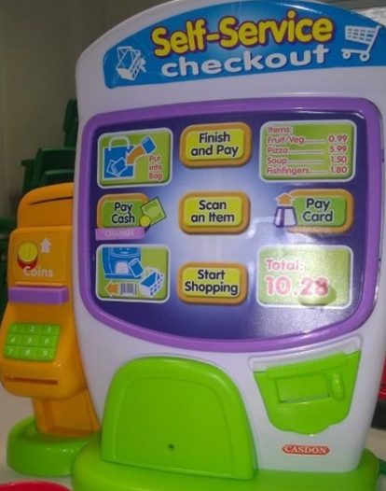
Generation Covid
Even before the pandemic,
career guidance had never been so important
Young people in a recession
Labour market turbulence impacting:
School leavers
Transitioners
All students
Why labels can be helpful
https://www.cedefop.europa.eu/files/2227_en.pdf

Slide 6
Effect of participation in career development on positive attitudes towards school
Odds ratio of the likelihood of students agreeing with the statement "Trying hard at school will help me get a good job”
Note: Odds ratio are adjusted for gender, socio-economic status, school type (private/public,class size, urban/rural,staff/student ratio), immigrant background, motivational factors (whether students skipped classes or days) and cognitive potential (whether students repeated a year of study).
Source: PISA 2018 database

Slide 7
New OECD approaches to career readiness: Teenage indicators of adult employment
Thinking about the future
career certainty: ability to name a job expected at age 30
career ambition: interest in progressing to higher education and professional/managerial employment
career alignment: matching of occupational and educational expectations
Exploring the future
career conversations: speaking to an adult about a career of interest
occupational preparation: participation in short occupationally-specific courses within general programmes of education
school-mediated work exploration: participation in job fairs, job shadowing and workplace visits.
Experiencing the future
part-time employment: participation in paid part-time or seasonal work
volunteering: participation in community-based volunteering
internships: participation in school-mediated work placements
Keep in touch with the work: Anthony.mann@oecd.org

Slide 8
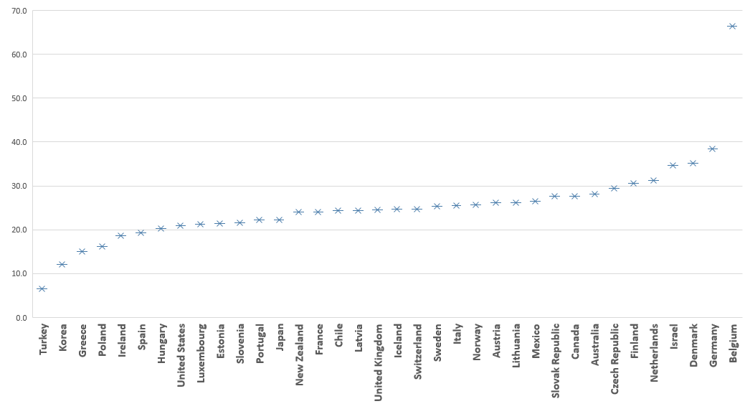
Uncertainty: Many young people are uncertain about their career expectations
28% of young Australians are uncertain about their career expectations - compared to 25% across the OECD

Slide 9
Teenage uncertainty: 2000 to 2018

Slide 10
Misalignment: High performing students with professional or managerial occupational expectations, but not planning to complete tertiary education
Misalignment ratio:
Australia: 4.0
OECD: 3.6
Source: PISA 2018 database

Slide 11
Participation in career development activities
OECD average and Australia, 2018
Source: PISA 2018 databases.
Notes:
Data relate only to OECD countries completing Educational Questionnaire in 2012 and 2018:
Australia
Austria
Belgium
Denmark
Hungary
Ireland
Italy
Korea
New Zealand
Slovak Republic
Slovenia

Slide 12
Participation in career development activities, Australia
- Socio-economic status, 2018
Source: PISA 2018 databases.
Notes:
Data relate only to OECD countries completing Educational Questionnaire in 2012 and 2018:
Australia
Austria
Belgium
Denmark
Hungary
Ireland
Italy
Korea
New Zealand
Slovak Republic
Slovenia

Slide 13
Participation in career development activities, Australia
- Gender, 2018
Source: PISA 2018 databases.
Notes:
Data relate only to OECD countries completing Educational Questionnaire in 2012 and 2018:
Australia
Austria
Belgium
Denmark
Hungary
Ireland
Italy
Korea
New Zealand
Slovak Republic
Slovenia

Slide 14
Career conversations: teenagers speaking adults about career aspirations
teenagers speaking with non-parental adults (especially teachers) about career aspirations

Slide 15
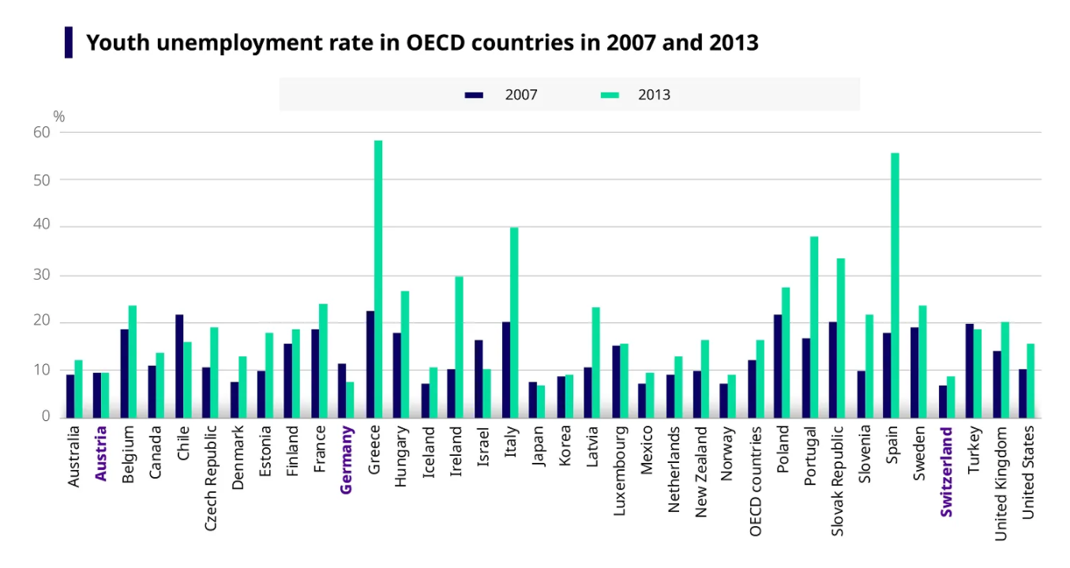
Thinking about the future (5)
Teenage interest in the skilled trades typically entered through Vocational Education and Training
Young people in countries with strong VET systems largely withstood the global surge in youth unemployment which followed the Great Financial Crisis (2007/08).

Slide 16
What young Australians think about VET
Teenage interest in the skilled trades (ISCO 7000) typically entered through Vocational Education and Training
Includes: house builders, bricklayers, carpenters, roofers, plasterers, glaziers, plumbers, refrigeration mechanics, painters, sheet metal workers, welders, motor vehicle mechanics, aircraft engineer mechanics, jewellery makers, dress makers, instrument makers, printers, electrical workers, butchers, bakers, tailors and cabinet-makers.

Slide 17
And finally, what jobs did Generation Covid aspire to at age 15

Slide 18
Next steps: career readiness in the pandemic
November/December 2020: OECD launches 12-month project aimed at helping countries and schools to improve the career readiness of young people.
Opportunity for policy officials and practitioners to get involved (no cost):
disseminating findings
sharing examples of effective practice
influencing future work. Email: Anthony.Mann@oecd.org.
Study will draw on further national longitudinal data and PISA datasets to help schools enhance career readiness, leading to the creation of national and institutional indicators.
Country analysis of PISA career-related data available for commissioning.
Also: new collaborative report from the international organisations on career guidance in the pandemic at the end of 2020.

Slide 19
Get in touch
Recent OECD work on career readiness
Dream Jobs: Teenagers’ Career Aspirations and the Future of Work
Working it out: Career Guidance and Employer Engagement
Seven Questions about Apprenticeship (last chapter)
Unlocking the potential of migrants
Career aspirations and nursing
Lessons from the Great Financial Crisis
Anthony Mann
Senior Policy Analyst
(Education and Skills)
Twitter: @AnthonyMannOECD
Anthony.Mann@oecd.org

Slide 22
Career concentration in Australia – girls (2000 and 2018)
 | Top 10 Girls
 | 2000 |  | 2018
 | Occupation | % | Occupation | %
1 | Teachers | 9.0 | Teachers | 10.3
2 | Doctors | 5.5 | Nursing and midwives | 9.1
3 | Hairdressers, barbers, beauticians and related workers | 5.1 | Doctors | 7.9
4 | Designers | 5.1 | Lawyers | 5.5
5 | Psychologists | 5.0 | Designers | 3.9
6 | Lawyers | 4.8 | Psychologists | 3.9
7 | Nursing and midwives | 4.3 | Veterinarians | 3.2
8 | Child-care workers | 3.6 | Physiotherapists | 3.1
9 | Authors, journalists and other writers | 3.6 | Architects | 2.6
10 | Physiotherapists and related associate professionals | 2.8 | Science and engineering professionals | 2.6
Total |  | 48.8 |  | 52.0

Slide 23
Career concentration in Australia – boys (2000 and 2018)
 | Top 10 Boys
 | 2000 |  | 2018
 | Occupation | % | Occupation | %
1 | ICT professionals | 12.6 | Science and engineering professionals | 5.8
2 | Motor vehicle mechanics and repairers | 5.3 | Doctors | 5.1
3 | Engineers | 4.1 | Sportspeople | 4.9
4 | Architects | 4.0 | Engineers | 4.9
5 | Carpenters and joiners | 3.3 | Electrical equipment installers and repairers | 4.1
6 | Doctors | 3.1 | ICT professionals | 4.1
7 | Business managers | 3.0 | Carpenters and joiners | 3.8
8 | Aircraft pilots and related associate professionals | 3.0 | Architects | 3.1
9 | Builders, traditional materials | 2.8 | Teachers | 3.1
10 | Lawyers | 2.8 | Designers | 3.0
Total |  | 44.0 |  | 41.8

Slide 24
Career concentration in Australia – migrant status (2018)
 | Native-born |  | Foreign-born
1 | Teachers | 7.5 | Doctors | 13.2
2 | Nursing and midwives | 4.9 | Science and engineering professionals | 5.7
3 | Doctors | 3.9 | Lawyers | 5.4
4 | Science and engineering Professionals | 3.6 | Teachers | 4.3
5 | Lawyers | 3.6 | Nursing and midwives | 4.1
6 | Designers | 3.5 | Engineers | 4.1
7 | Sportspeople | 3.1 | Designers | 3.4
8 | Physiotherapists | 3.1 | Architects | 3.4
9 | Architects | 2.6 | ICT professionals | 2.9
10 | Psychologists | 2.6 | Sportspeople | 2.6
Total |  | 38.4 |  | 49.1

Slide 25
Career concentration in Australia – socio-economic status (2018)
 | Least advantaged quartile |  | Most advantaged quartile
1 | Teachers | 6.7 | Doctors | 10.2
2 | Nursing and midwives | 5.3 | Lawyers | 6.4
3 | Doctors | 3.9 | Science and engineering professionals | 6.1
4 | Sportspeople | 3.8 | Teachers | 5.3
5 | Designers | 3.4 | Nursing and midwives | 4.1
6 | Carpenters and joiners | 3.2 | Engineers | 4.1
7 | Electrical equipment installers and repairers | 2.9 | Architects | 4.0
8 | Police officers | 2.6 | Psychologists | 3.7
9 | Lawyers | 2.5 | Physiotherapists | 3.2
10 | Science and engineering professionals | 2.3 | Designers | 3.0
Total |  | 36.6 |  | 50.0

Slide 26
Concentration of occupational expectations between 2000 and 2018
Percentage of students naming 10 most popular occupations (OECD average)
Australia | 2000 | 2018
Girls | 49% | 52%
Boys | 44% | 42%
All | 39% | 41%
Source: PISA databases. Countries reporting career expectations in PISA 2000, 2003, 2006, 2015 and 2018.

Slide 27
Many teenagers aspire to jobs that are at high risk of automation

Slide 28
High performers who do not expect to be professionals or managers
Source: PISA 2018 database

Slide 29
High performers who do not expect to complete tertiary education
Source: PISA 2018 database

Slide 30
High performers who do not expect to be professionals or managers by gender
Source: PISA 2018 database

Slide 31
High performing students with professional or managerial occupational expectations, but not planning to complete tertiary education
Misalignment ratio:
Australia: 4.0
OECD: 3.6
Source: PISA 2018 database

Slide 32
Concentration of occupational expectations by participation in career development activities – OECD averages
* Difference is statistically significant
Source: PISA 2018 database.

Slide 33
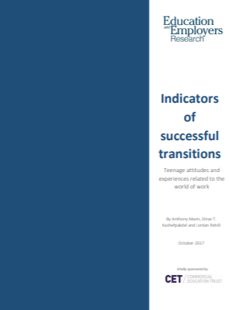
How much is enough?
16 indicators from UK longitudinal studies
Thinking about the future
Talking about the future
Experiencing the future
Thinking about school
https://www.educationandemployers.org/research/indicators-of-successful-transitions/

Slide 34
Effective career guidance …
Starts early (primary) and intensifies around key decision points
Connects classroom learning with future economic lives
Provides easy access to trustworthy labour market information and advice/guidance from well-trained and impartial professionals
Addresses information asymmetries about specific professions and challenges stereotyping
Broadens understanding of the labour market – focusing in particular occupations which are poorly understood and of strategic importance
Targets young people from disadvantaged backgrounds for the greatest levels of intervention
Is experiential with rich and plentiful engagement from the world of work
Notes:
Ethnography

Slide 35
Employer engagement to boost young people’s understanding of jobs and careers needs to be…
authentic - enabling first-hand encounters
commonplace – volume of encounters matters
valued (relevant) – by young people themselves
varied - different activities can be associated with different outcomes for different types of students
contextualised - by effective career guidance
personalised – in recognition of existing work-related networks and aspirations
begun young – addressing attitudes and expectations from primary schooling
Source: Mann et al. 2018. Employer engagement in Education. EEF.

Slide 36

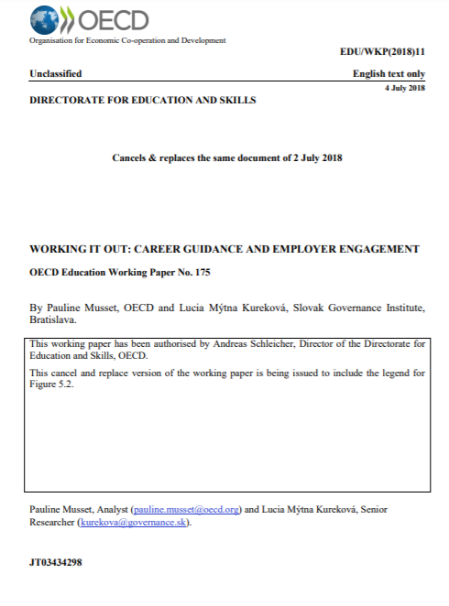

Reading…
https://www.oecd.org/education/dream-jobs-teenagers-career-aspirations-and-the-future-of-work.htm
http://www.oecd.org/officialdocuments/publicdisplaydocumentpdf/?cote=EDU/WKP(2018)11&docLanguage=En
http://www.oecd.org/publications/pisa-2018-results-volume-ii-b5fd1b8f-en.htm

Slide 37

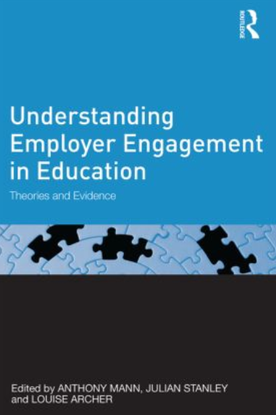
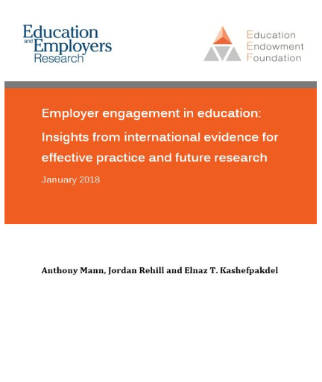
https://www.routledge.com/Essays-on-Employer-Engagement-in-Education/Mann-Huddleston-Kashefpakdel/p/book/9781138501041
https://www.routledge.com/Understanding-Employer-Engagement-in-Education-Theories-and-evidence/Mann-Stanley-Archer/p/book/9780415823463
https://educationendowmentfoundation.org.uk/evidence-summaries/evidence-reviews/employer-engagement/

