Slide 1
Growing up well: What difference can schools make in young people’s transition to adulthood?
Sinan Gemici
AVETRA OctoberVET 2013
Ballarat

Slide 2
Overview

Slide 3
Data
Longitudinal Surveys of Australian Youth

Slide 4
What is LSAY?
Track a nationally representative sample of young Australians as they move from school into post-school destinations
Starts at age 15 and covers a 10-year period
Collects information about education and training, work, and social development
Purpose: To develop an evidence-base on factors that facilitate a successful transition into adulthood

Slide 5
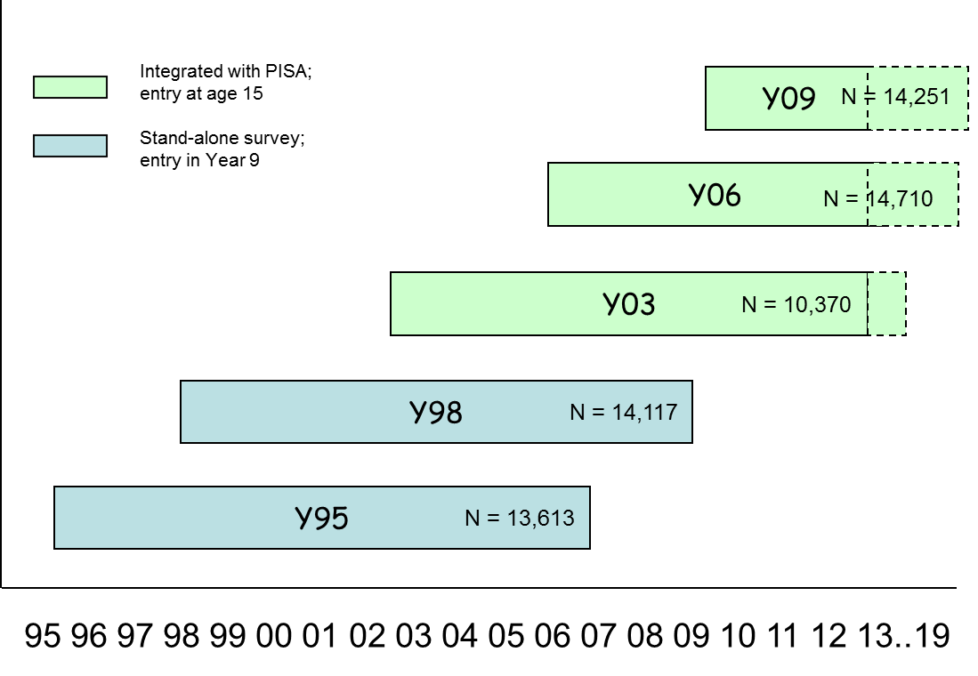
Structure of LSAY

Slide 6
Want to find out more?
www.lsay.edu.au

Slide 8
What we know already
Policy focus on schools both nationally and internationally¹
School characteristics have been found to influence test scores and year 12 completion²
¹ Gonski et al. 2011; OECD 2010
² Curtis & McMillan 2008; NOUS Group et al. 2011

Slide 9
What we want to know
Policy question: Are there school characteristics that policy can influence to improve students’ transition to higher education?
Which school characteristics have a positive impact on:
Australian Tertiary Admission Rank (ATAR) scores
the probability of university enrolment by age 19

Slide 10
Student characteristics
Socio-demographic measures
Gender, Indigenous Status, Australian born, English spoken at home, SES
Academic Performance
Combination of mathematics, reading and science scores in PISA
Aspirations and Perceptions
Year 12 completion plans, tertiary education aspirations, perceptions of school
Notes:
PL
LSAY has a wide range of variables measured at the student level. In fact, it is one of the few data-sets in the world to contain such a diverse range of variables.
In this study, we have focussed on :
Socio-demographic measures, such as gender, indigeneity, how long a student has been in Australia (and their own parents immigration status), languages spoken at home, and a constructed measure of SES (based on a range of variables including parental education and occupation, along with a range of variables measuring the amount and types of possessions found in the family home
Academic achievement: PISA tests of mathematical, science and reading literacy, Year 12 completion, and Tertiary entrance rank (TER) when investigating university entrance. That is, what is the impact of key variables over and above an individual’s own TER score.
Aspirations and Perceptions: Plans to complete Year 12, their own post-school study plans (go to uni, get an apprenticeship, go to TAFE, get a job, other), and their perception of the school experience (
All of these variables have been included in the regression equations.

Slide 11
School characteristics
School Demographics
Size
SES
Resources & Capacity
Class size
Student-teacher ratio
Academic Orientation
Academic pressure from parents
Student selection criteria
School Autonomy
Responsibility for resources
Responsibility for the curriculum
Providing for Student Needs
Level of extracurricular activities
Perceptions of the school experience
Competition
Competing for students with other schools in the area
Academic achievement
Gender mix
LBOTE
Degree of teacher shortage
Proportion of certified teachers
Proportion of highly qualified teachers
Primary resource base
Quality of educational materials
Use of streaming
Exposure to work
Influence of business on the curriculum
Teacher vs. counsellor-based career advice
Sector
Location
Notes:
PL
These are all the school-level variables we have included in the model. Most of the are taken from the PISA 2006 principals questionnaire. Some (e.g., school-SES, school-LBOTE, school academic achievement) are aggregated up to the school level based on student-level variables.

Slide 12
How much do schools matter?
ATAR scores
Uni Enrolment (accounting for ATAR scores)
Notes:
SG
The multi-level model allows us to determine how big an impact on the outcome the school and the student level variables make.
From this graph, we can see that the school level variables contribute about 20% to an individual’s TER score. So whilst individual background characteristics are dominant, schools can and do make a useful contribution to individual outcomes.
For the remainder of this seminar, we focus on the school-level variables as this is where our interest lies.

Slide 13
Which school characteristics matter for ATAR?
School Demographics
Size
SES
Resources & Capacity
Class size
Student-teacher ratio
Academic Orientation
Academic pressure from parents
Student selection criteria
School Autonomy
Responsibility for resources
Responsibility for the curriculum
Providing for Student Needs
Level of extracurricular activities
Perceptions of the school experience
Competition
Competing for students with other schools in the area
Academic achievement
Gender mix
LBOTE
Degree of teacher shortage
Proportion of certified teachers
Proportion of highly qualified teachers
Primary resource base
Quality of educational materials
Use of streaming
Exposure to work
Influence of business on the curriculum
Teacher vs. counsellor-based career advice
Sector
Location
Notes:
SG
The yellow variables emerged as statistically significant for TER over and above individual student characteristics.

Slide 14
Which school characteristics matter most for ATAR?
Notes:
SG

Slide 15
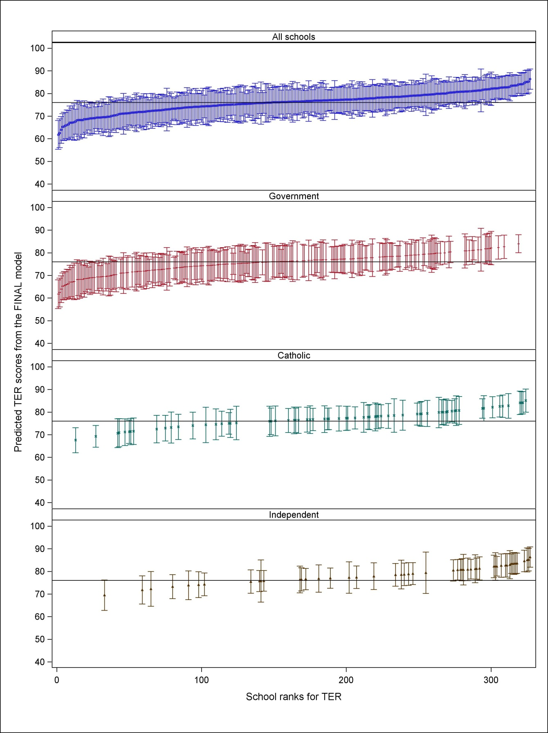
Differences by school sector for ATAR
Notes:
SG
The caterpillar plots are based on the final model (i.e., they account for all statistically significant student and school-level characteristics.
Predictions are based on a student with average characteristics attending each school.
It is important to note that schools are significantly different from the mean TER if the error bars do not cross the mean line.
Points to note:
Confidence of the estimates has improved (smaller error bars) in the final model
Once the characteristics have been included, school performance can change (highlight the change in performance for the Catholic schools).
Schools have wide range of TER scores. Government schools perform both good and bad, but there is clearly a large number of Government schools that are in the bottom end (once you have accounted for the cohort at these schools). Catholic and Independent schools are much more clustered at the top end of the TER distribution

Slide 16
Summary of most important school characteristics
School Characteristics | ATAR scores
Non-government | ✓
Single-sex | ✓
Moderate exposure to the world of work | ✓
Strong parental pressure on schools | ✓
Larger school size | ✓
School Characteristics | University Enrolment (accounting for ATAR scores)
Higher proportion of LBOTE students | ✓
Non-government | ✓
Higher SES of student body | ✓
Notes:
SG
TO BE ADAPTED TO THE 8 NEW DOMAINS

Slide 17
What we learn from this research
School attributes do matter
Further research needed to untangle aspects of ‘differentiation’ (effects of competition, gender separation, streaming)
Role of Government schools
Non-selective government schools have limited control over some important factors
Role of school-level SES deserves attention
Impact on higher education equity targets (20 per cent of higher education enrolments at the undergraduate level to be from people of a low SES background by 2020)
Let’s not forget: Successful lives are about more than just ATAR and uni
Role of VET in Schools/tertiary VET pathways

Slide 19
What we know already
Policy focus on low-SES youth (COAG targets)
Underprivileged students have lower rates of Year 12 completion and university uptake¹
The quality and socioeconomic profile of a school matters with respect to academic outcomes²
¹ Steering Committee for the Review of Government Service Provision 2011
² Gonski et al. 2011; OECD 2010; Perry & McConney 2010; Watson & Ryan 2010

Slide 20
What we want to know
Policy question: Can we improve outcomes by sending low-SES kids to better schools?
Do low-SES students benefit from attending high-quality academic schools with respect to Year 12 completion?
If so, do they benefit to a greater or lesser extent than their more advantaged peers?
What role does individual academic performance play?

Slide 21
What is our measure of ‘high academic quality’?
Top quartile of schools with the highest combined ATAR scores and university enrolment probabilities from the previous paper

Slide 22
Results

Slide 23
What we learn from this research
Academic school quality matters much more for the most vulnerable students:
those with poor academic performance and a low-SES background
Coming from an advantaged background can insulate students from early school leaving, even in the lowest-quality schools
High individual academic performance can offset the negative effects of being low-SES and attending low-quality schools

