Slide 1
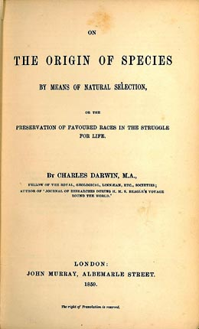
On The Origin of Standards: evolution from a UK commission on excellence to standards for VET teachers
Getty Images
www.historylink.org
Dr Carolyn Johnstone
OctoberVET, 18 October 2016

Slide 2
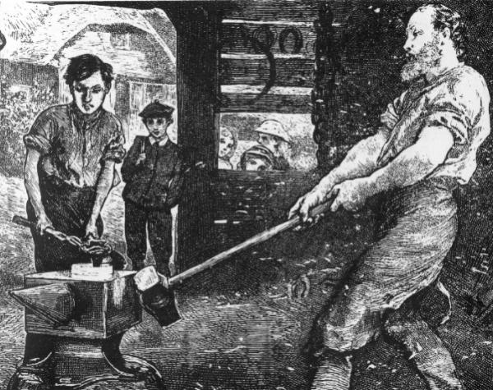
19th Century – City of London
Capabilities
Freeman of the City
Bearing scot and lot
Resident in the City
Able to perform the agreements of the indenture
Obligations
Supply board and lodgings
Necessary clothing
Instruction in the trade
(Teach reading and writing)
No right to give apprentice tasks outside the trade
1883 Blacksmith and apprentice
British History Online http://www.british-history.ac.uk/plea-memoranda-rolls/vol2/xxx-xlvii

Slide 3
4 enabling factors
21st Century – 2013 CAVTL
4 characteristics
C1. a clear line of sight to work on all vocational programmes;
C2. ‘dual professional’ teachers and trainers who combine occupational and pedagogical expertise;
C3. access to industry-standard facilities and equipment, reflecting the ways in which technology is transforming work;
C4. clear escalators to higher level vocational learning, developing and combining deep knowledge and skills.
E1. a two-way street – genuine collaboration between colleges and training providers, and employers;
E2. vocational qualifications that include both a national core and a locally tailored element;
E3. leadership, management and governance which combines a focus on the quality of vocational teaching and learning, with an approach to leading through collaboration in order to build the two-way street;
E4. a collaborative approach to accountability in order to empower VET professionals to maximise impact for employers and learners.

Slide 4
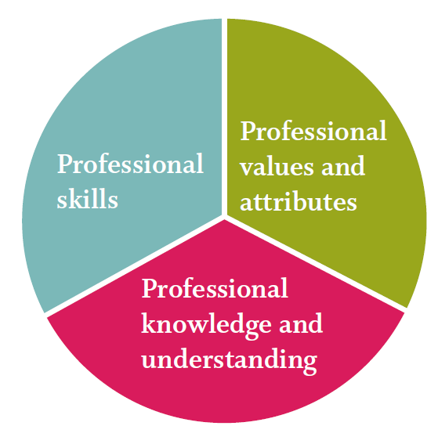
2014 Professional Standards
Professional values and attributes
Develop your own judgement of what works and does not work in your teaching and training
1 Reflect on what works best in your teaching and learning to meet the diverse needs of learners
2 Evaluate and challenge your practice, values and beliefs
3 Inspire, motivate and raise aspirations of learners through your enthusiasm and knowledge
4 Be creative and innovative in selecting and adapting strategies to help learners to learn
5 Value and promote social and cultural diversity, equality of opportunity and inclusion
6 Build positive and collaborative relationships with colleagues and learners
Professional knowledge and understanding
Develop deep and critically informed knowledge and understanding in theory and practice
7- 12
Professional skills
Develop your expertise and skills to ensure the best outcomes for learners
13-20
E1

Slide 5
2014 Professional Standards
Professional values and attributes
Develop your own judgement of what works and does not work in your teaching and training
1-6
Professional knowledge and understanding
Develop deep and critically informed knowledge and understanding in theory and practice
7 Maintain and update knowledge of your subject and/or vocational area
8 Maintain and update your knowledge of educational research to develop evidence-based practice
9 Apply theoretical understanding of effective practice in teaching, learning and assessment drawing on research and other evidence
10 Evaluate your practice with others and assess its impact on learning
11 Manage and promote positive learner behaviour
12 Understand the teaching and professional role and your responsibilities
Professional skills
Develop your expertise and skills to ensure the best outcomes for learners
13-20
C2
C2
C2

Slide 6
2014 Professional Standards
Professional values and attributes
Develop your own judgement of what works and does not work in your teaching and training
1-6
Professional knowledge and understanding
Develop deep and critically informed knowledge and understanding in theory and practice
7-12
Professional skills
Develop your expertise and skills to ensure the best outcomes for learners
13 Motivate and inspire learners to promote achievement and develop their skills to enable progression
14 Plan and deliver effective learning programmes for diverse groups or individuals in a safe and inclusive environment
15 Promote the benefits of technology and support learners in its use
16 Address the mathematics and English needs of learners and work creatively to overcome individual barriers to learning
17 Enable learners to share responsibility for their own learning and assessment, setting goals that stretch and challenge
18 Apply appropriate and fair methods of assessment and provide constructive and timely feedback to support progression and achievement
19 Maintain and update your teaching and training expertise and vocational skills through collaboration with employers
20 Contribute to organisational development and quality improvement through collaboration with others
C4
C3
C4
C2
E1
E4

Slide 7
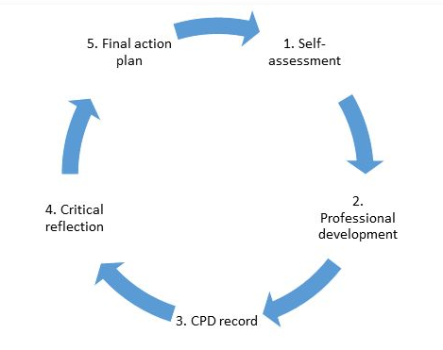
Qualified Teacher Learning & Skills (QTLS)
a) Increase employers’ understanding of the benefits and parity with QTS
b) Improve the rigour of QTLS to improve its parity with QTS
• Include a mandatory requirement for applicants to self-assess their knowledge and skills against the 2014 professional standards at the start of the professional formation process.
• Introduce more emphasis on industrial updating and dual professionalism.
• Evaluate the review and moderation process to identify ways in which the rigour of the process can be improved.
e) Extend the reach of QTLS to other settings, e.g. work based learning
• Review the evidence requirements and language of the online workbook in order to broaden the reach of QTLS to other settings, for example work based learning.
f) Develop CPD opportunities for progression for those with QTLS
g) Develop opportunities to provide practitioners with space, either in or out of their work setting, to have professional conversations
C2
C2
E4
c) Encourage peer support and mentoring throughout the process
d) Review the currency of maths and English qualifications
E1
C1
E4

Slide 8
QTLS Impact Study;
QTLS Structural Review
C1
C2
Getty Images
C2
C4
C4
E1
C2
E1
E4
E4
E4
E1
C3
C2
C2
C2
Carolyn Johnstone
c.johnstone@federation.edu.au

