Slide 1
Is technology an enabler for disadvantaged learners? The use of learning technologies in rural further education colleges in the U.K.
Les Burr
PhD Candidate (Federation University)
Wodonga TAFE
OctoberVET 2016
Notes:
Learner perspective.

Slide 2
Research significance
Although the total number of students engaged in tertiary education has risen dramatically over the past 25 years, regional equity remains unfulfilled (Burnheim and Harvey, 2013).
Addressing the employment, economic and social imbalances between urban and regional areas by increasing the participation of regional learners in tertiary education is generally agreed to be of national and international importance.
Examining the significance and role of blended learning technologies is critical to increasing participation rates in rural and regional areas. However, ICT, distance, finance and inexperience as a formal learner are frequently identified as barriers in and of themselves.
Notes:
Regional development. People stay where they are trained.

Slide 3
The road less travelled - from FE to HE
Pathways and articulations from FE to HE are elusive (Rushbrook,1997). (only since 1911!)
Pathways and articulations are complex, confusing and under-realised (Smith and Brennan Kemmis, 2014). Piecemeal
The aspirational gap between FE and HE is too great for many mature age prospective students (Parry, 2011). Transition shock.
A different route is required to widen participation. Bricks and mortar are not helping.
In Australia there is limited understanding and experience of the mixed sector. Under-researched.
Notes:
Piecemeal was a mutant with the ability to absorb different energy frequencies and store them within his body. (Peicemeal was forced) to travel across the world to absorb the dispersed energies. Absorbing the energy, Piecemeal grew larger and larger until he looked like a 700-pound monstrosity. Finally, Piecemeal's body exploded, and in that instant his mind formed a new being. The new entity set about warping reality.

Slide 4
Research Method: Case studies HE in FE – why these countries?
Australia (4 sites - soon)
Predicted high growth from a low base
Changing policy environment
Under-researched
England (4 sites – May/June 2016)
Leads Australian policy and practice
Wide variety of HE in FE models
Scotland (1 site – June 2016)
Recent history of championing the advantages of HE in FE
Learner survey (n = 99) Learner interview (n = 20)
Teacher interviews (n = 18) Management interviews (n = 4)

Slide 5
Cohort demographics

Slide 6
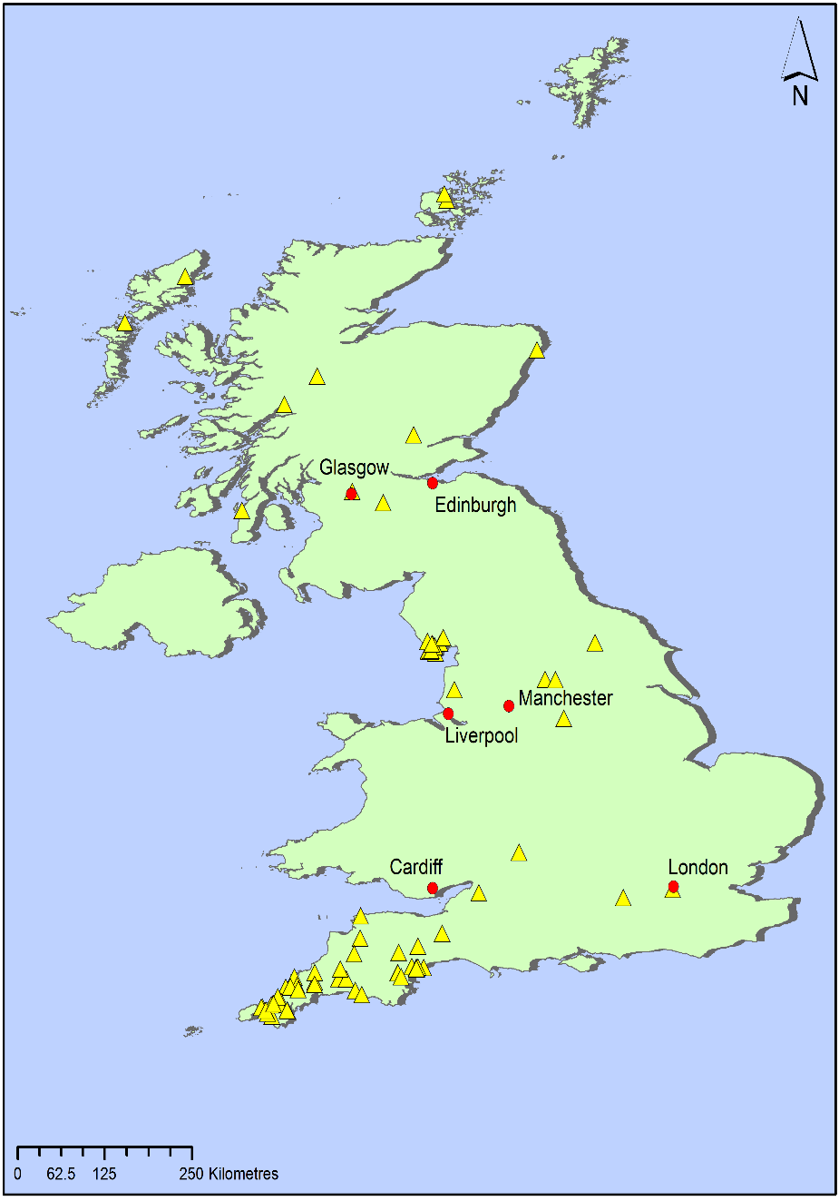
U.K. rural cohort demographics
Foundation degree + hons degree Level 4, 5, 6 (=Aus 5, 6, 7)
90% employed
Mature age
Average 25 hours / week
95% good or > internet
Laptop 30% Phone 25% PC 15%
Most with 3 devices
80% studied at home

Slide 7
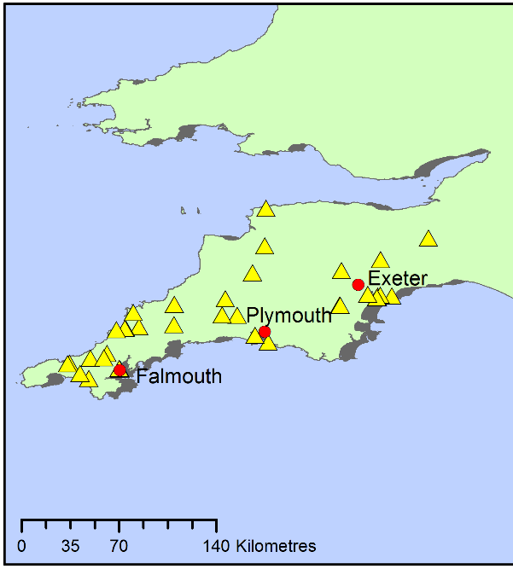
Not-for-profit RTO - rural cohort
Long standing uni partnership
8-week modules, 3 days f-2-f
High performing – 63% H1 or H2
High FD retention rate > 90%
No campus – multiple pop up delivery sites – Cert IV entry
75% of FD continue
3 universities 8 FE colleges
Highly paid staff

Slide 8
Use of learning technologies when engaging with your teacher

Slide 9
Use of learning technologies when engaging with content

Slide 10
How do you engage with other learners

Slide 12
What three key factors attracted you to this course?

Slide 13
Which parts of your online experience have enabled successful engagement with the course this semester?

Slide 14
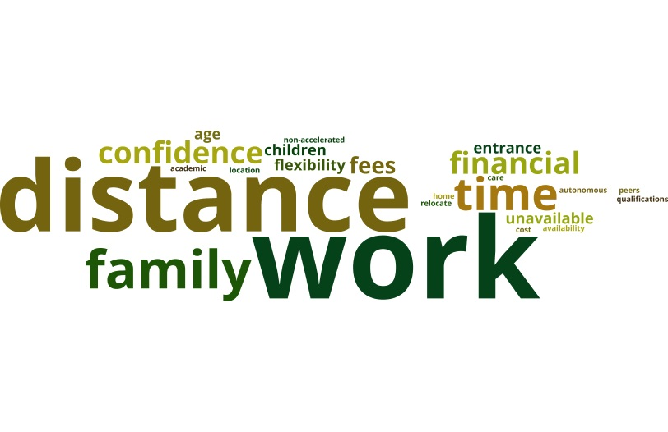
What three key factors prevented you from undertaking this course face to face?

Slide 15
How did the technology requirements impact on your ability to undertake the course?

Slide 16
For this cohort in SW England … is technology an enabler for disadvantaged learners?
Quality teaching Resilience
Multiple disadvantages Virtual social presence
Social and cultural isolation Replicated f2f instruction
Distance is not measured in miles Flexible design is critical
Time is not measured in hours Hard working
100% online is not successful Facebook is “everything”
Online library is heavily used

Slide 17
For this cohort in SW England … is technology an enabler for disadvantaged learners?
Financial: student loan, revolves around work, career-centred
ICT: not infrastructure, maybe skills
Distance: pop up f-2-f, online library
Inexperience as formal learners: Quality teaching, informal social media, flexible design

