Slide 1
Good practice in apprenticeship systems: Evidence from an international study
Erica Smith
University of Ballarat, Australia
OctoberVET 2013

Slide 2
Apprenticeship-the silver bullet?
In the current economic climate, internationally governments are searching for policy fixes for youth unemployment and apprenticeship is currently seen as a major solution.
However, apprenticeship varies considerably among countries and many aspects are culturally, socially, politically and economically specific.
In the end, apprenticeship is about what happens in workplaces and training providers

Slide 3
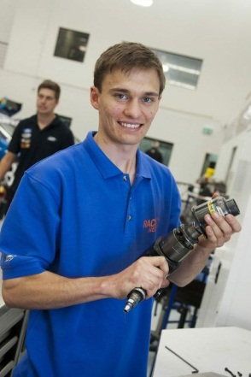
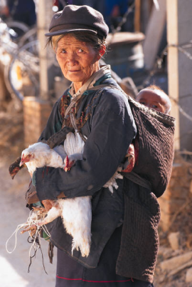
Societal expectations
Apprentices
Countries: Solve youth unemployment
Countries: Address youth disengagement
Help women and workers in the informal economy
Trade unions: Improve working conditions through apprenticeships
Parents: Get children into a secure job.

Slide 4
Economic expectations
Apprentices
Companies: A well trained workforce
Companies: Develop future managers
Countries: International Competitiveness
Companies: Improve productivity and profits

Slide 5
Possible futures for the Indian apprenticeship system: project for ILO & World Bank Indian offices
To review international good practice in apprenticeships and workplace learning in a range of countries;
To identify success factors to develop recommendations and key principles for a ‘model’ apprenticeship system;
To review recent reports and literature on the formal apprenticeship system in India;
To recommend options for future development of the Indian apprenticeship system.
Indian system very small for population, in a limited range of occupations, and in an economy that is mostly informal.

Slide 6
Why might countries have small apprenticeship systems?
No tradition of apprenticeships;
Low status of VET;
Poor reputation of existing system;
Overly bureaucratic system;
Limited to a narrow range of occupations
Limited to school-leavers;
Apprentices not paid enough or anything;
Large informal economy (not addressed in this paper)

Slide 7
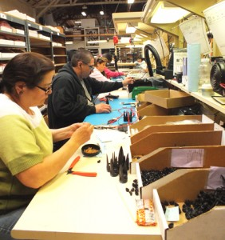
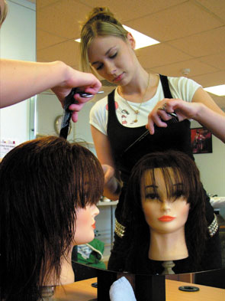
The project’s method: 1. International learnings on apprenticeship
Country case studies on 11 countries’ apprenticeship systems, written to a specified format by a team of country experts, validated by in-country academic and government experts;
Cross case analysis of the country case studies including a summary of the issues, strengths and weaknesses;
Development of a framework for a model apprenticeship system, including the identification of key features grouped under the headings engagement, quality, outcomes, and public policy
implications.

Slide 8
The countries
More developed economies:
Australia, Canada, England, France, Germany, United States;
Less developed economies:
Egypt, Indonesia, South Africa, Turkey.
An Indian case study for comparison purposes
Country experts: Linda Miller, AbouBakr Abdeen Badawi, M’hamed Dif, Andreas Saniter, Ludger Deitmer, Bibhuti Roy, Nicolas Serriere, Salim Akoojee, Özlem Ünlühisarcıklı, Robert Lerman.

Slide 9
Emphasis on young people
Typology of availability of apprenticeships to adults and/or young people adults
Predominantly for young people
Egypt, France Germany, India, Turkey
Routinely includes both young people and adults
Predominantly for adults
Australia, England, Indonesia, South Africa
Canada, United States

Slide 10
Degree of change in systems
Germany, Turkey and US: Relative stability.
Australia and UK: Expansion into new occupational areas and to include adults as well as young people; also ‘existing workers.’
South Africa: new ‘learnerships’

Slide 11
Expansion risks
Potential quality problems which can tarnish the system;
Employers may not be aware of responsibilities and might do the wrong thing;
Completion rates may be low at first;
Over-hasty establishment in new occupations could lead to low-quality curriculum;
Temptation to establish ‘differently-badged’ systems (eg South Africa, Australia, Egypt) to boost numbers quickly;
Inadequate buy-in from stakeholders

Slide 12
Expansion strategies 1: Systems
Introduction of third-party employers (eg GTOs in Australia);
Strategies for participation by groups currently excluded, eg adults;
Strategies for participation by minority groups;
Broader and deeper engagement of stakeholders;
Pathways to higher level qualifications;
Encouragement through industrial relations or other systesm for apprentice qualifications to be desired or required by employers/receive higher pay;
Counter-cyclical measures to address recessions.

Slide 13
Expansion strategies 2: Marketing
Promotion of the ‘brand’ by governments;
Promotion as a valued school-leaving pathway with deep connection into secondary schools;
Education of secondary school and other careers staff about apprenticeship.

Slide 14
Principles for a ‘model apprenticeship system’ – nine groupings
Broad occupational coverage (especially important for gender balance);
Participation;
National government structures;
Stakeholders;
Quality systems, training providers, employers;
Simplification and harmonisation;
Incentives;
Provision for the apprentice;
Support for employers.

Slide 15
Principles for a model system: Government structures and social partners
Government policy addresses employment and training issues;
Relative responsibilities of different levels of government clearly defined
Rigorous qualifications that are regularly updated
A systematic process for adding new qualifications
Good data systems
All major social partners represented at all levels of the system

Slide 16
Principles for a model system: Participation
Apprenticeships available in all industries and a range of occupations (eg those undertaken by women as well as men, in rural as well as urban occupations);
Open to people of all ages and people with disabilities;
Clear pathways for school-leavers and also for those without entry qualifications;
Pathways from off-the-job programs eg
pre-apprenticeships;
Pathways beyond apprenticeship into
higher education & higher level employment.

Slide 17
The promise: employers
Financial incentives for enterprises subject to satisfactory performance;
Public funding for training providers;
Discounted – but liveable – wages for apprentices;
Support for employers especially SMEs;
Provision of suggested workplace curriculum;
Easily available system for information eg Ellis Chart in Canada;
Third party entities such as Australia's Group Training Organisations.

Slide 18
The promise: apprentices
A recognised qualification and an onward pathway;
A good chance of successful completion;
A good chance of permanent employment at the end of the contract;
Provision of off the job training at a good training provider alongside apprentices from other companies;
Opportunity to switch employers
for good reason;
Learning support and case
management.

Slide 19
Public policy success measures
Value for money - cost of policy measures versus fiscal or social benefit;
Involvement of industry at several levels;
Industry reports adequate supply of skills;
Proportion of 15-24 year olds in apprenticeships;
Reduction in youth unemployment; and
Lower levels of skills shortage

Slide 20
Principles proposed for the Indian system
Each national context differs
For India, we coined the term ‘flexible standardisation’
Core quality and equity principles:
Equal chance for all workers in appropriate occupations;
Formal qualifications within national qualification system;
Clear guidelines for employers about responsibilities and training, easily accessible;
System for overseeing quality of off-the-job training.

Slide 21
Outcomes of the project: Change
Establishment of small high-level working party by DGET, Ministry of Labour and Employment, based on the options paper.
Parts of report used by ILO Geneva to feed into G20 meeting on youth unemployment – Sept 2012. New EU ‘guarantee’ on youth employment
World Bank pilot projects 2013

Slide 22
Recent Interest
O2 building (Millenium Dome), Greenwich

Slide 23
Contacts
Erica Smith e.smith@ballarat.edu.au
Co-author Associate Professor Ros Brennan Kemmis
rbrennan@csu.edu.au
The authors of the country case studies: Dr Linda Miller, Dr AbouBakr Abdeen Badawi, Dr M’hamed Dif, Dr Andreas Saniter and Dr Ludger Deitmer, Dr Bibuthi Roy, Nicolas Serriere, Dr Salim Akoojee, Associate Professor Ozlem Unluhisarcikli, and Dr Robert Lerman.
The reports will be published by ILO soon!

